Slide 1
Ppt for geography b.a part 3,topic:Suez canal date:29/07/20
By Rhicha jyotsna
Assistant professor geography
M.l arya college kasba

Slide 2
The Suez Canal is a man-made waterway
connecting the Mediterranean Sea to the Indian
Ocean via the Red Sea.
❖ It enables a more direct route for shipping
between Europe and Asia, effectively allowing for
passage from the North Atlantic to the Indian
Ocean without having to circumnavigate the
African continent.
❖ The waterway is vital for international trade
and, as a result, has been at the centre of conflict
since it opened in 1869._x0000_

Slide 3
❖ The Suez Canal is about 193.3 km in length that
stretches from Port Said on the Mediterranean Sea in the
north to the city of Suez in the south.
The canal connects the Mediterranean and Red Sea
and divides Egypt from the Sinai Peninsula.
❖ The unique geographical position of the Suez Canal
makes it the shortest route. The canal separates
the African continent from Asia, and it provides the
shortest maritime route between Europe and the lands
lying around the Indian and western Pacific oceans.
❖ The Canal route achieves saving in distance between
the ports north and south of the canal, the matter that is
translated into other saving in time, fuel consumption
and ship operating costs ._x0000_

Slide 4
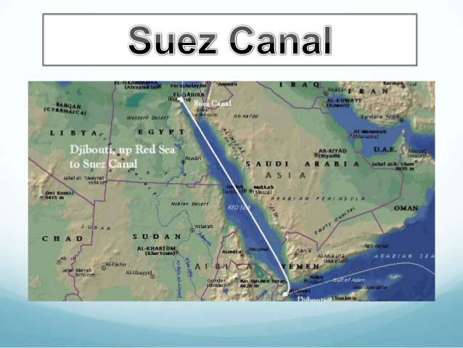

Slide 5
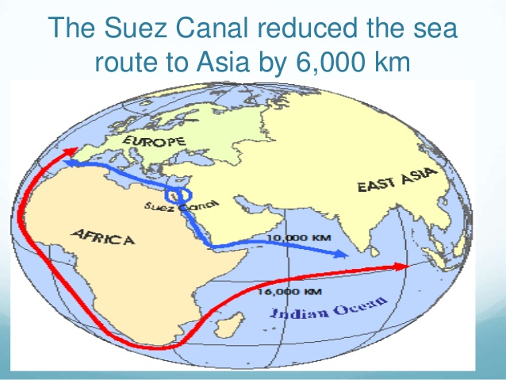

Slide 6
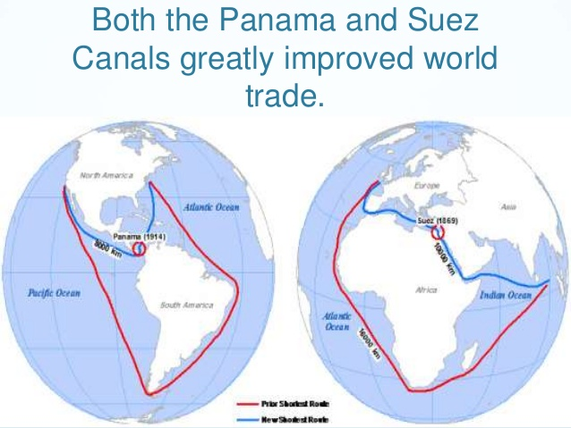

Slide 7
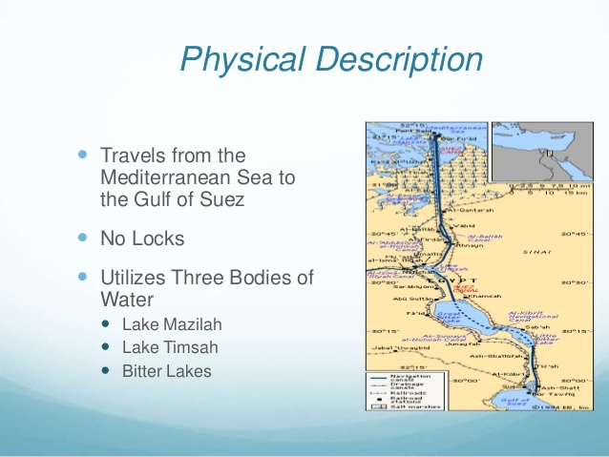

Slide 8
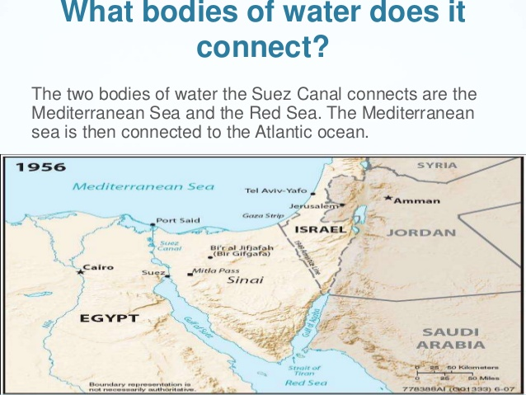

Slide 9
