Slide 1
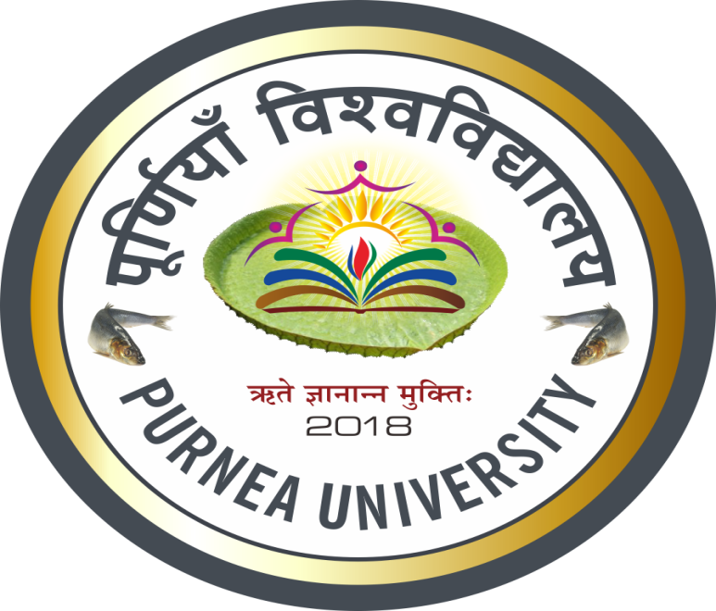
PURNEA UNIVERSITY, PURNEA
M.L.ARYA COLLEGE KASBA
DEPARTMENT OF POLITICAL SCIENCE ,GUEST FACULTY
DR.ANUNAY PRAKASH SINHA

Slide 2
The Cold War has had many effects on society, from the end of the war up until today. In Russia, military spending was cut dramatically and quickly. The effects of this were very large, seeing as the military-industrial sector had previously employed one of every five Soviet adultsand its dismantling left hundreds of millions throughout the former Soviet Union unemployed

Slide 3
After Russia embarked on economic reforms in the 1990s, it suffered a financial crisis and a recession more severe than the United States and Germany had experienced during the Great Depression.Russian living standards have worsened overall in the post–Cold War years, although the economy has resumed growth since 1995.It wasn't until 2005 that the average post-communist country had returned to 1989 levels of per-Capita GDP, although some are still lagging far behind

Slide 4
The legacy of the Cold War continues to influence world affairs.After the dissolution of the Soviet Union, the post–Cold War world is widely considered as unipolar, with the United States the sole remaining superpower.The Cold War defined the political role of the United States in the post–World War II world: by 1989 the United States held military alliances with 50 countries, and had 1.5 million troops posted abroad in 117 countries.

Slide 5
Military expenditures by the US during the Cold War years were estimated to have been $8 trillion, while nearly 100,000 Americans lost their lives in the Korean War and Vietnam War. Although the loss of life among Soviet soldiers is difficult to estimate, as a share of their gross national product the financial cost for the Soviet Union was far higher than that of the United States

Slide 6
The legacy of Cold War conflict, however, is not always easily erased, as many of the economic and social tensions that were exploited to fuel Cold War competition in parts of the Third World remain acute. The breakdown of state control in a number of areas formerly ruled by Communist governments has produced new civil and ethnic conflicts, particularly in the former Yugoslavia.

Slide 7
Many nuclear legacies can be identified from the Cold War, such as the availability of new technologies for nuclear power and energy, and the use of radiation for improving medical treatment and health. Environmental remediation, industrial production, research science, and technology development have all benefited from the carefully managed application of radiation and other nuclear processes.

