Slide 1
Ppt for geography hons part2,paper 4,unit 3,topic:drought
By
Rhicha jyotsna
Assistant professor geography
M.l arya college kasba
To be continued

Slide 2
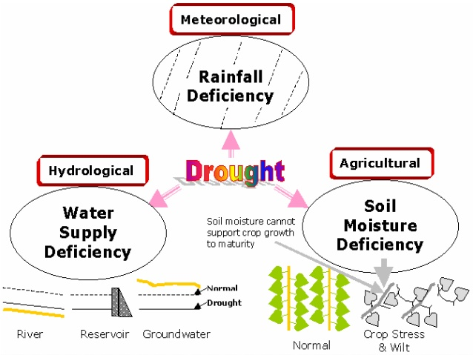

Slide 7
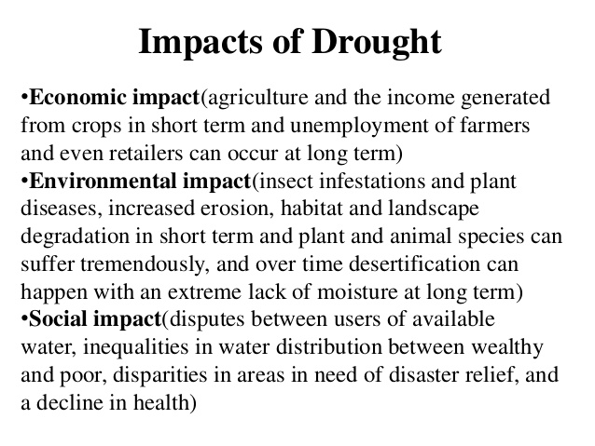

Slide 9
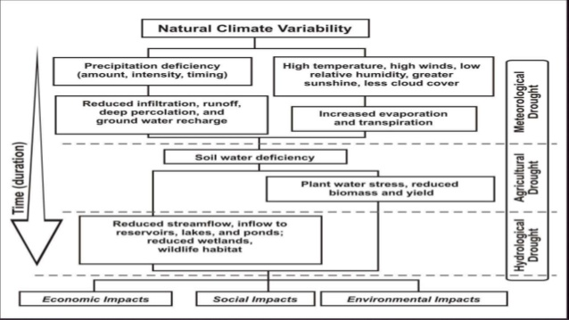

Slide 14
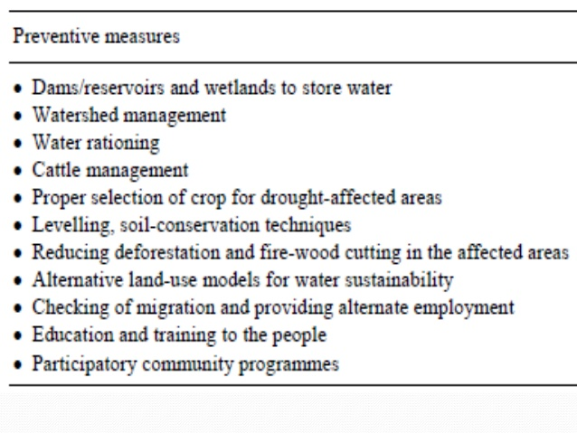

Slide 16
The end

