Slide 1
Ppt for Geography(Hons),part2,paper4,unit3,section b
Topic:Shifting cultivation
Date:12/05/20
By
Rhicha Jyotsna
Assistant Professor Geography
M.l arya college kasba
Purnea University,purnia

Slide 2
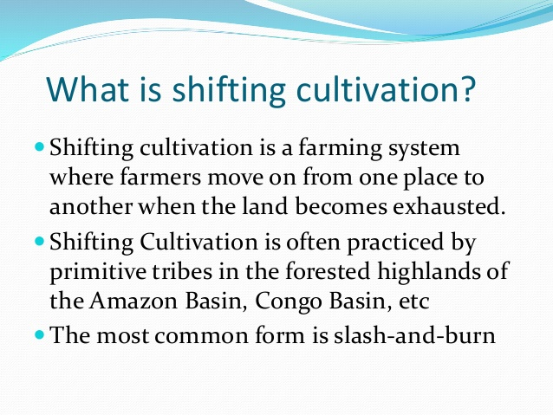

Slide 3
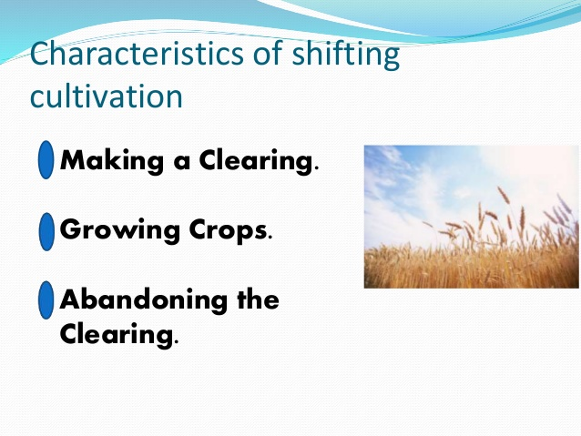

Slide 4
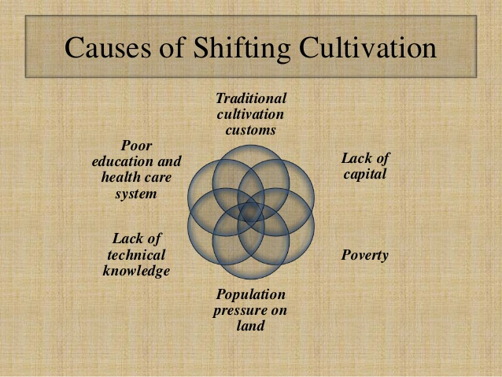

Slide 5
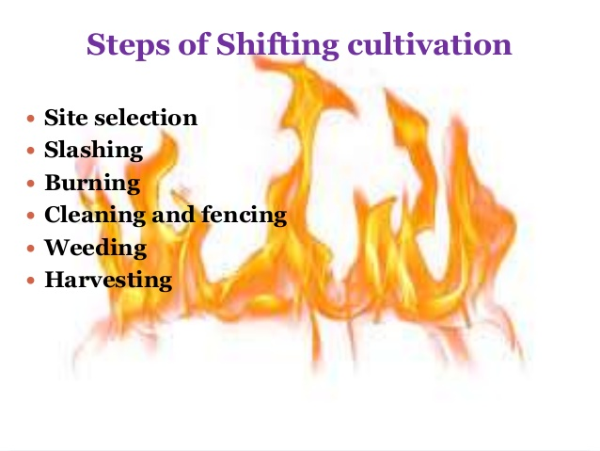

Slide 6
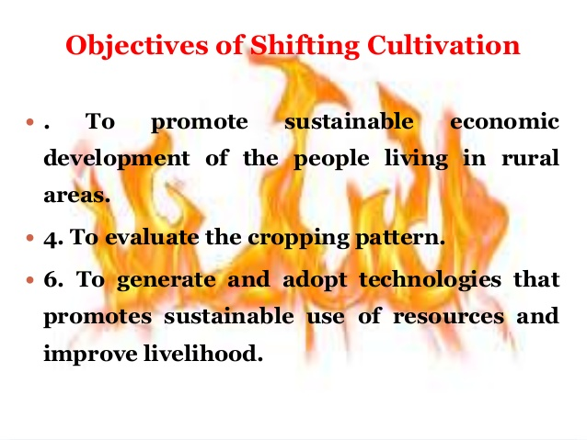

Slide 7
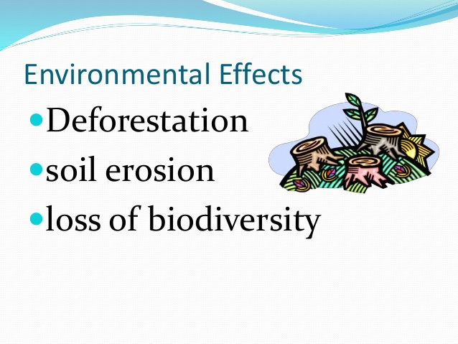

Slide 8
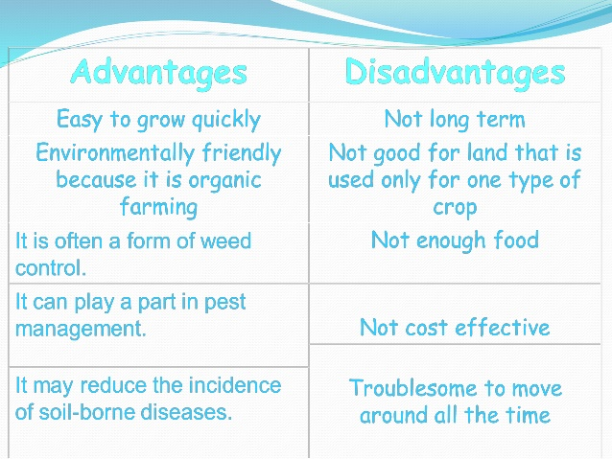

Slide 9
To be continued

