Slide 1
Ppt for Geography(Hons)part 2,paper4,unit3,sectionb,topic The Gonds
By
Rhicha Jyotsna
Assistant Professor Geography
M.l Arya college kasba
Purnea University,Purnia
To be contiued

Slide 2
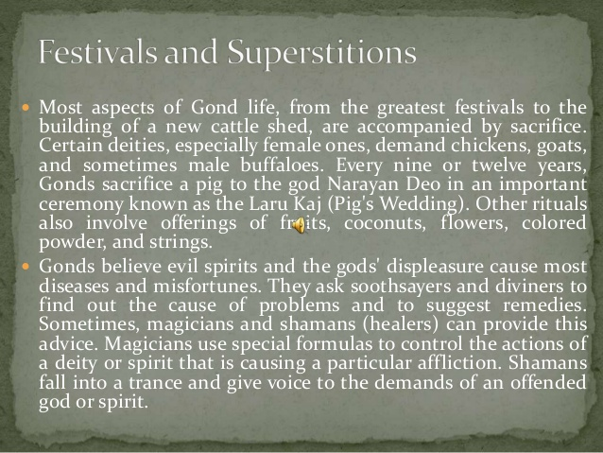

Slide 3


Slide 4


Slide 5
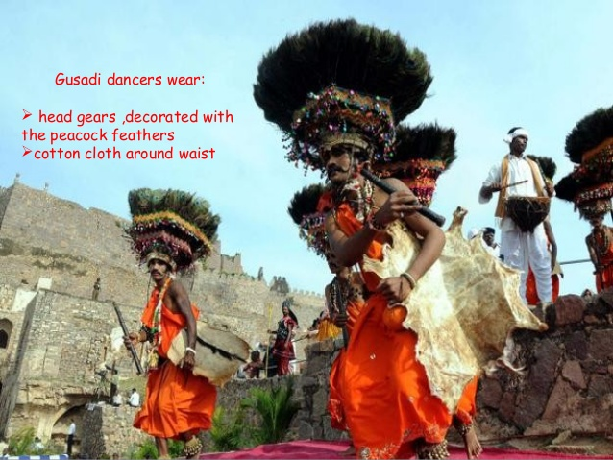

Slide 6
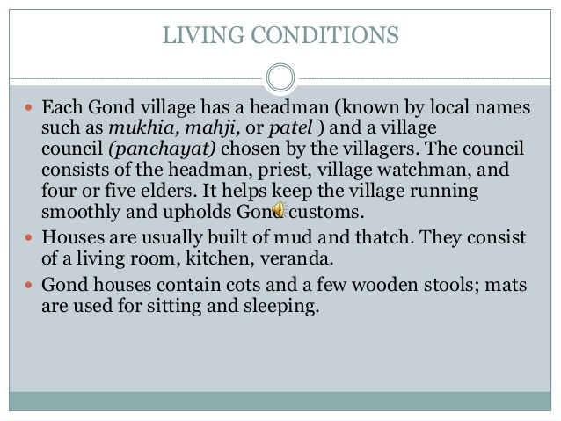

Slide 7
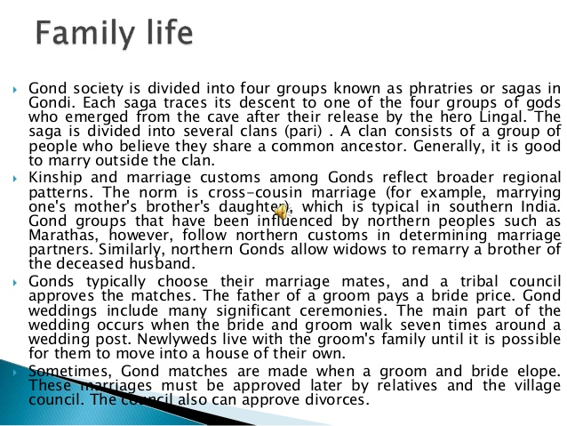

Slide 8
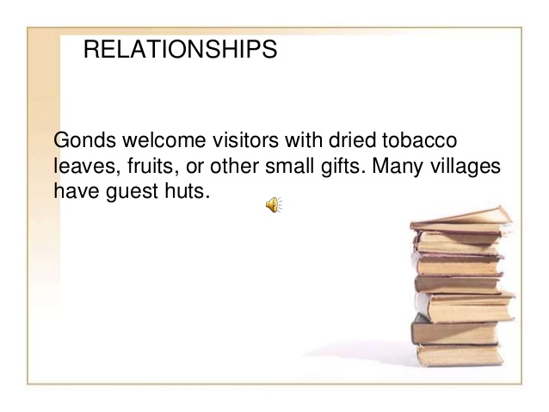

Slide 9
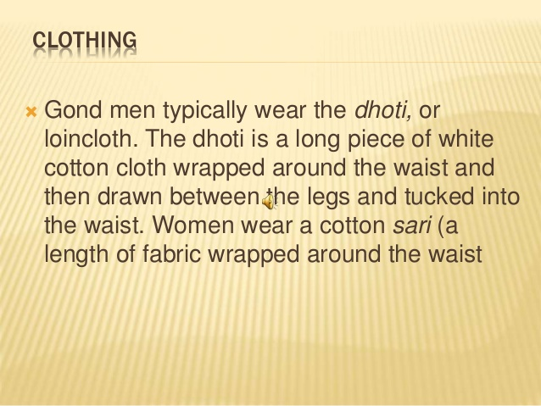

Slide 10
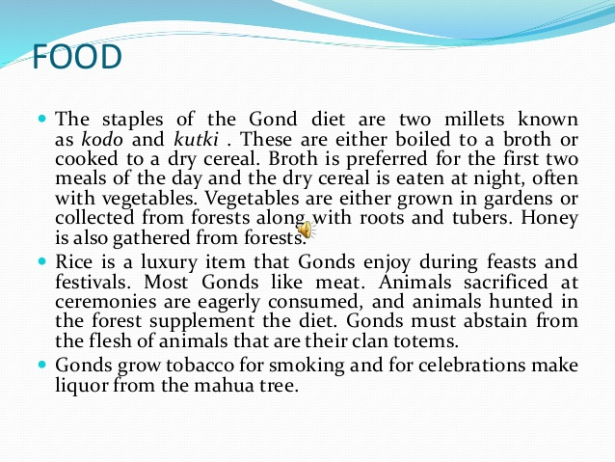

Slide 11
To be continued

