Slide 1
Ppt for geography hons part 2,paper4,unit1 sectiona,topic: temperate grassland Date:16/05/20
By Rhicha jyotsna
Assistant professor Geography
M.l arya college kasba
To be continued

Slide 5
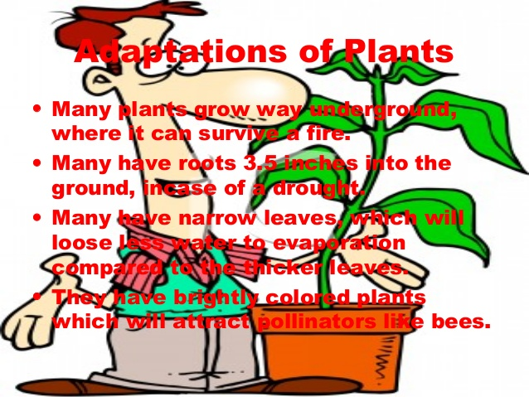

Slide 6
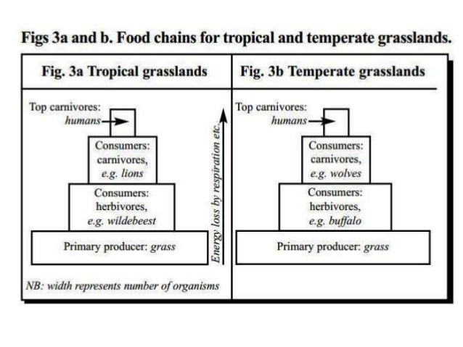

Slide 7
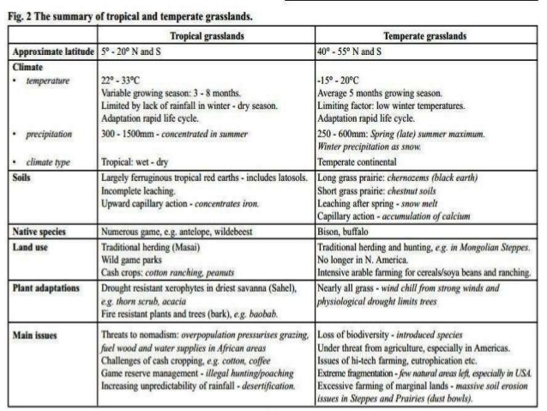

Slide 11
The end

