Slide 1
Ppt for Geography(Hons),part2,paper4,unit3,section b,topic:Shifting cultivation
By
Rhicha jyotsna
Assiistant Professor Geography
M.l Arya College kasba
Purnea University,Purnia

Slide 4
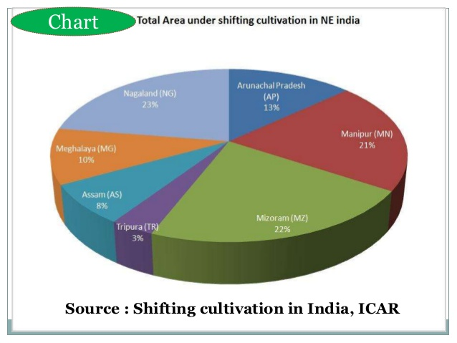

Slide 6
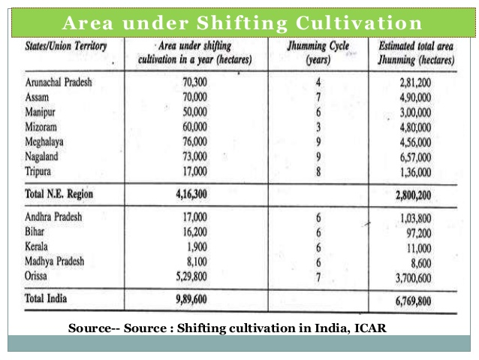

Slide 11
The end

