Slide 1
Ppt for geography Hons part2,paper4,unit 3,section b,topic:natural hazard flood Date:21/05/20
By
Rhicha Jyotsna
Assistant professor geography
M.l arya college kasba
To be continued

Slide 2
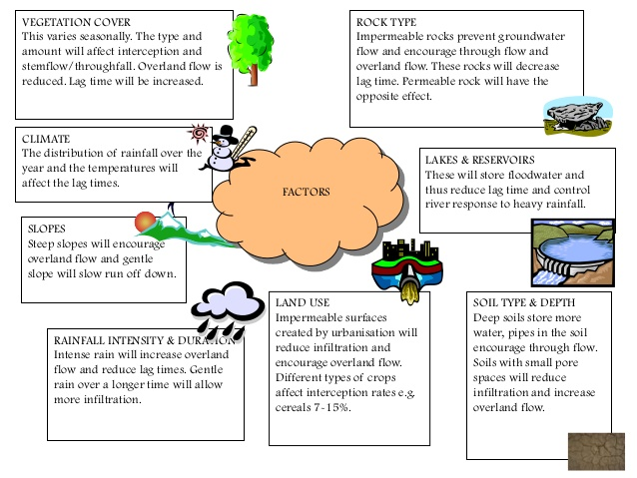

Slide 10
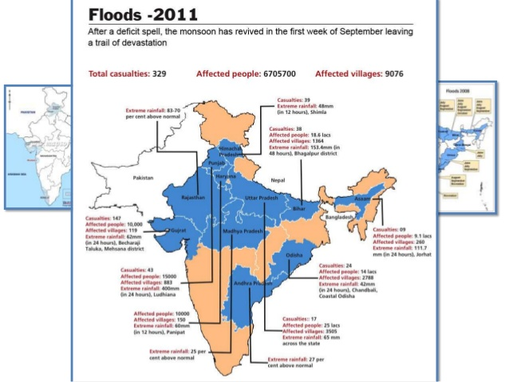

Slide 13
The end

