Slide 1
Ppt for geography hons part2,unit4,paper4,section b,topic:Migration Date:28/05/20
By
Rhicha jyotsna
Assistant professor geography
M.l arya college kasba

Slide 2
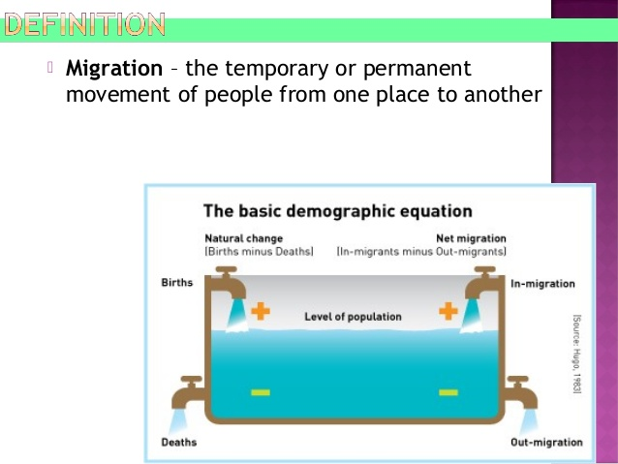

Slide 3
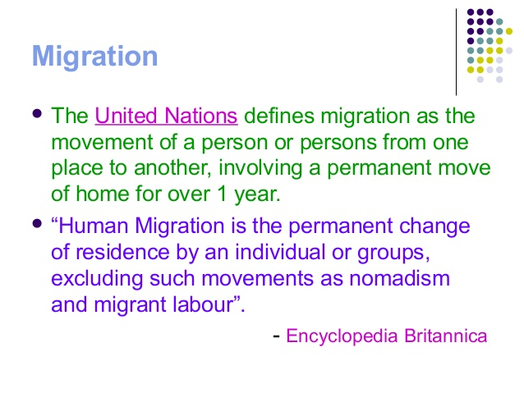

Slide 4
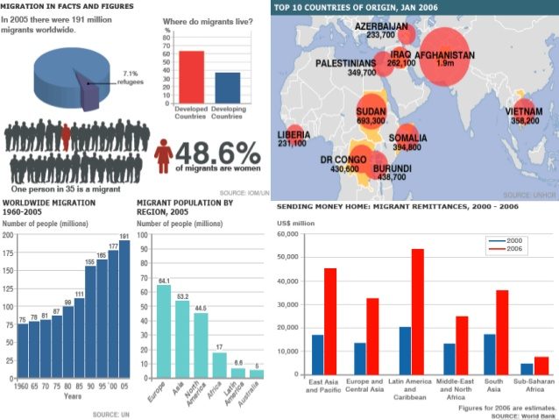

Slide 5
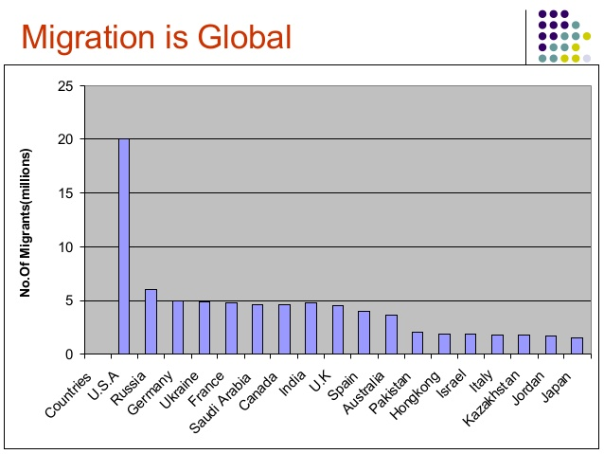

Slide 6
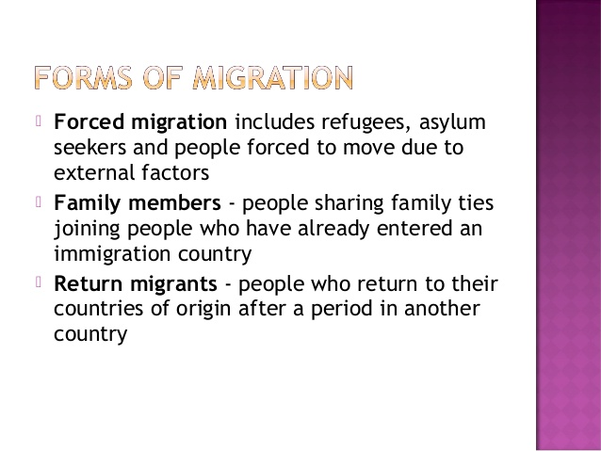
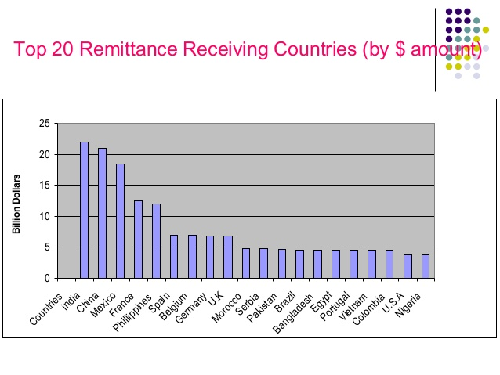

Slide 7
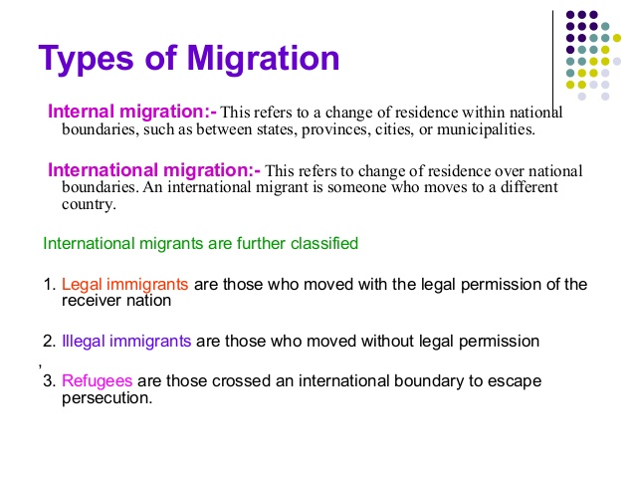

Slide 8
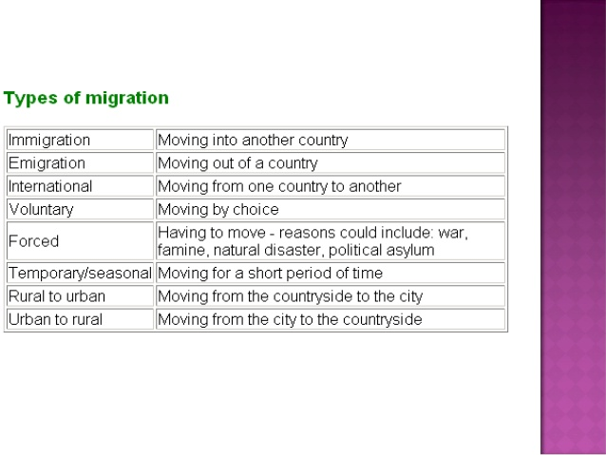

Slide 9


Slide 10
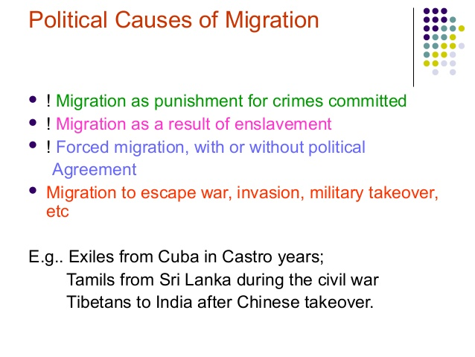

Slide 11
The end

