Slide 1
Ppt for geography(Hons),part2,paper4,unit3,section b,topic:gujjar
To be continued

Slide 5
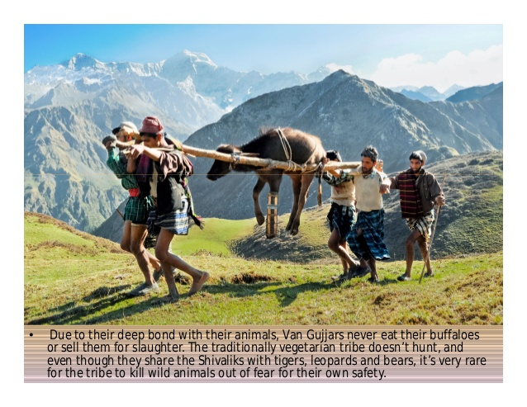

Slide 6
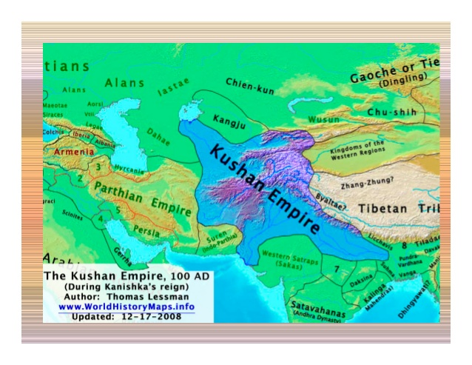

Slide 7
The end

