Slide 1
Ppt for geography Hons part2,paper4,unit3,section b,topic:Natural hazard flood ,date:20/05/20
By
Rhicha jyotsna
Assistant professor geography
M.l Arya college kasba

Slide 2
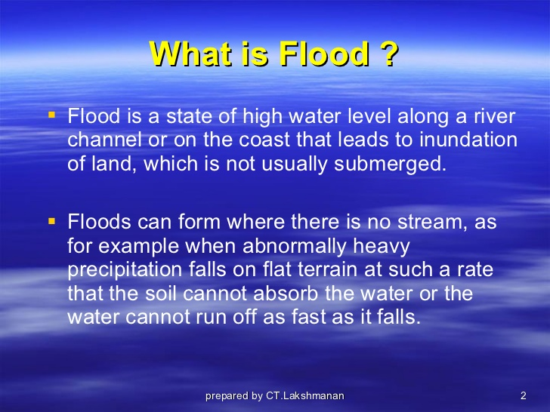

Slide 3
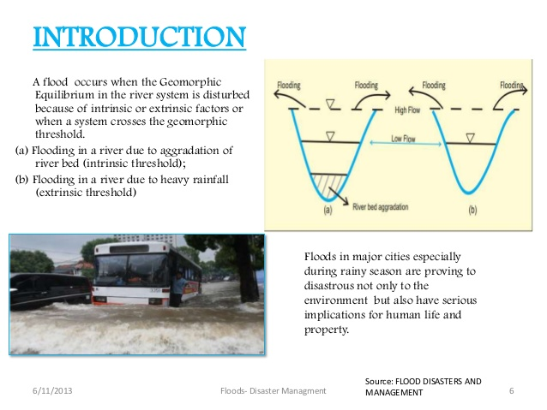

Slide 4
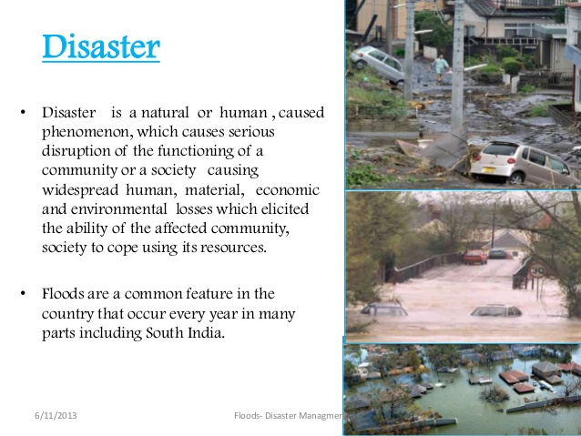

Slide 5
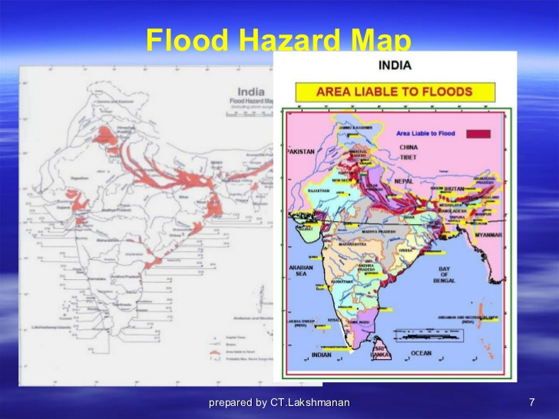

Slide 6
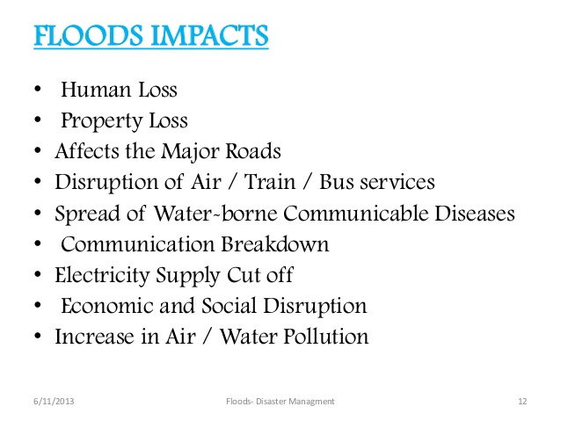

Slide 7
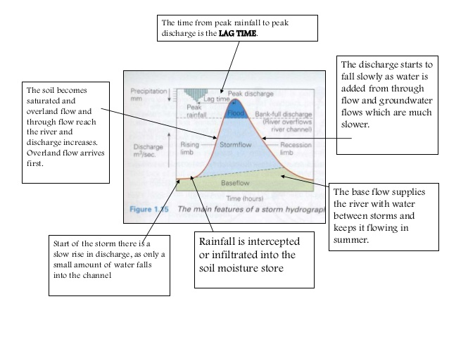

Slide 8
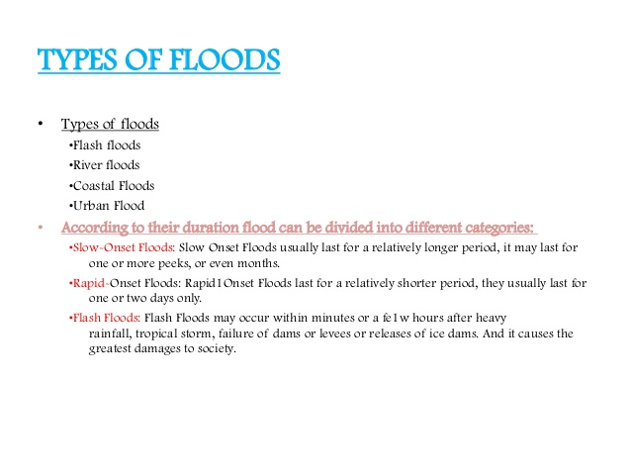

Slide 9
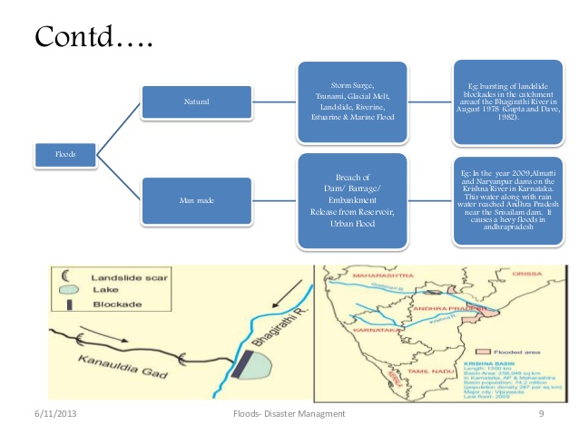

Slide 10
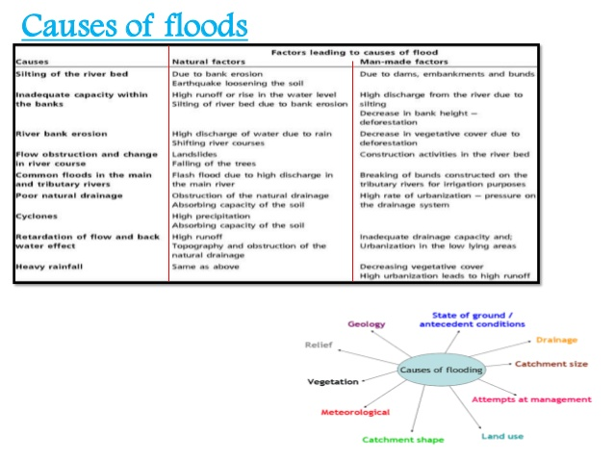

Slide 11
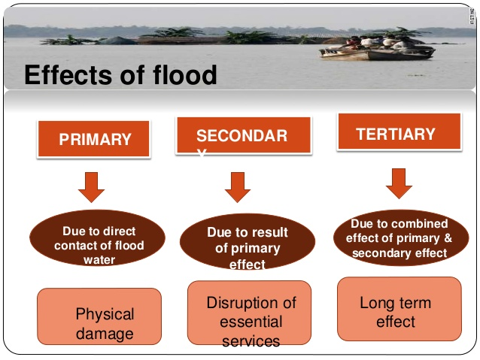

Slide 12
To be continued

