Slide 1
Ppt for Geography Hons part2,paper4,unit1,sectionA Topic:Desert environment ,date:19/05/20
By
Rhicha jyotsna
Assistant Professor Geography
M.l Arya college kasba
Purnea University,purnia
To be continued

Slide 2
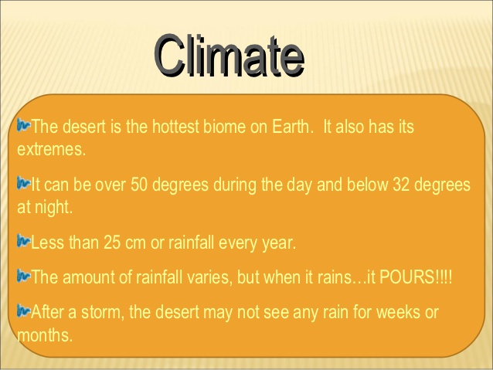

Slide 3
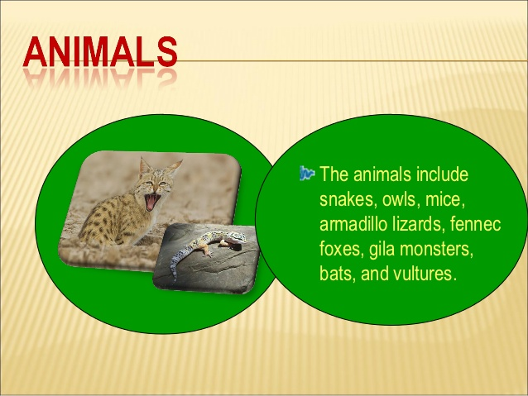

Slide 4
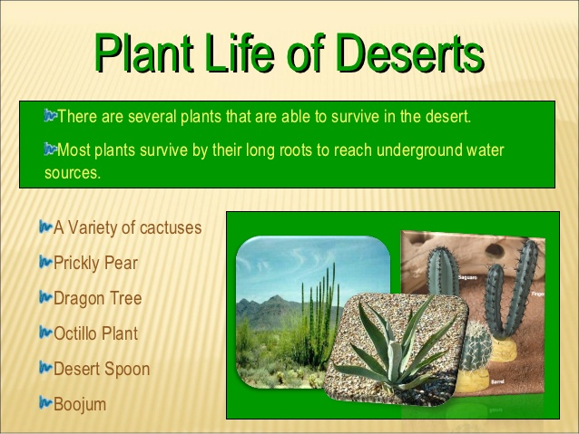

Slide 5
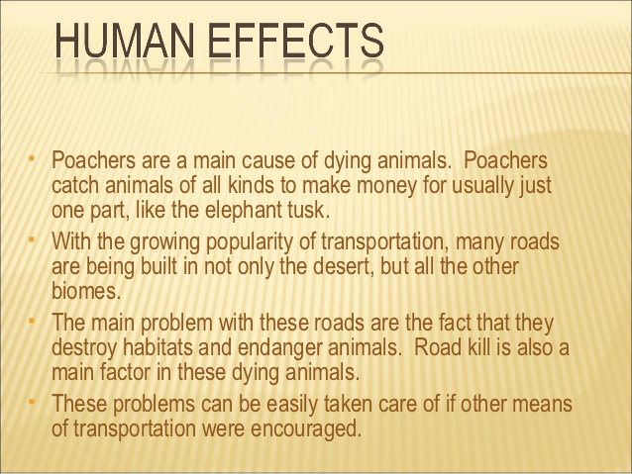

Slide 6
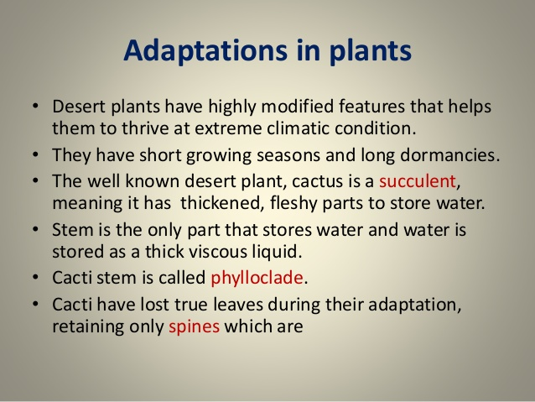

Slide 7
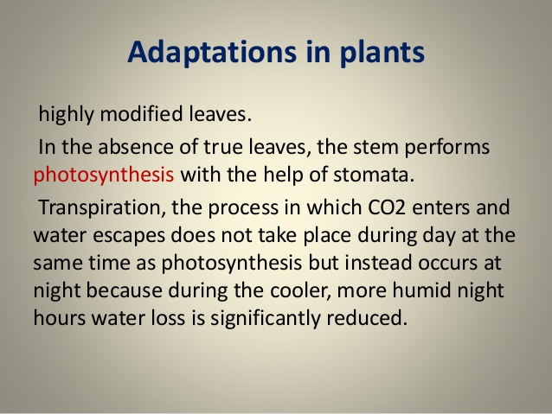

Slide 8
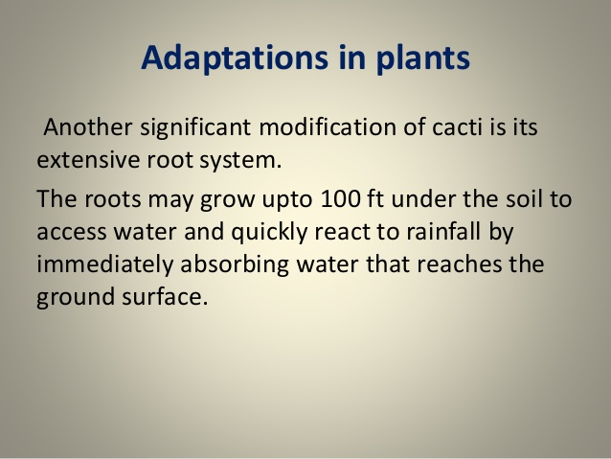

Slide 9
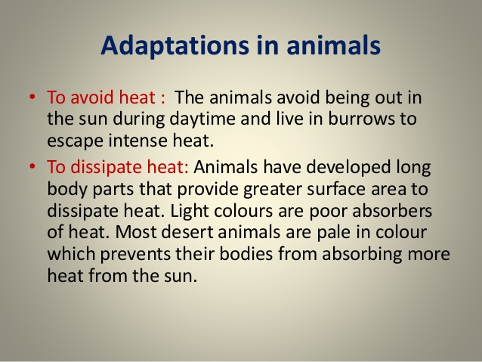

Slide 10
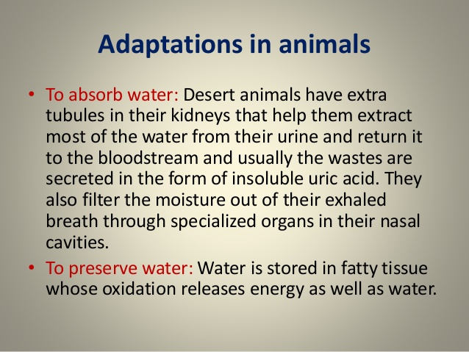

Slide 11
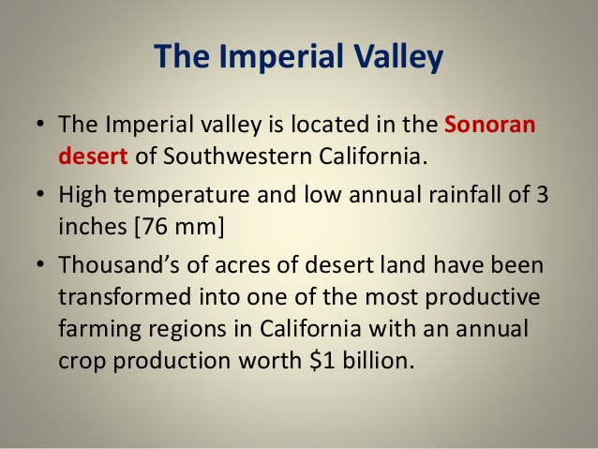

Slide 12
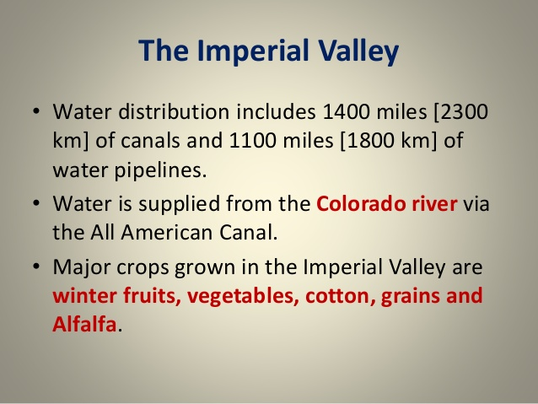

Slide 13
The end

