Slide 1
Ppt for geography (Hons)Part 2,paper4,unit 3,section B,Topic:gujjars
By
Rhicha jyotsna
Assistant Professor Geography
M.l Arya College kasba
Purnea University,Purnia

Slide 4
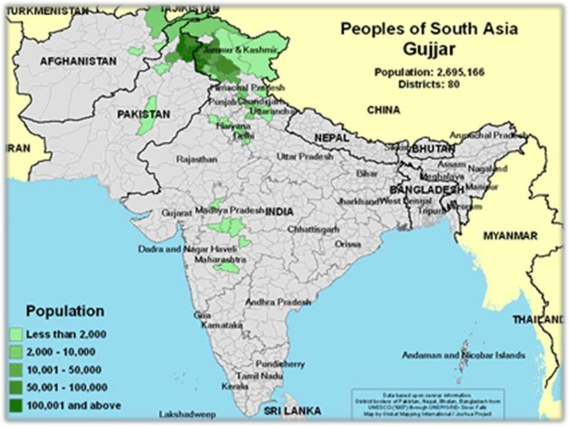

Slide 10
To be continued

