Slide 1
Ppt for geography(Hons)part2,paper4,unit 3 ,topic:The Gonds Date:8/05/20
By
Rhicha jyotsna
Assistant Professor Geography
M.l Arya College kasba
Purnea University,purnia

Slide 4
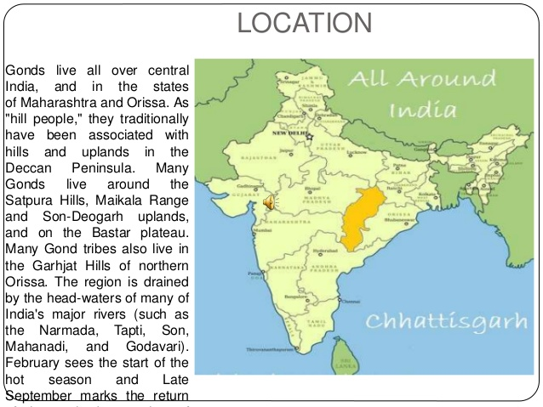

Slide 5
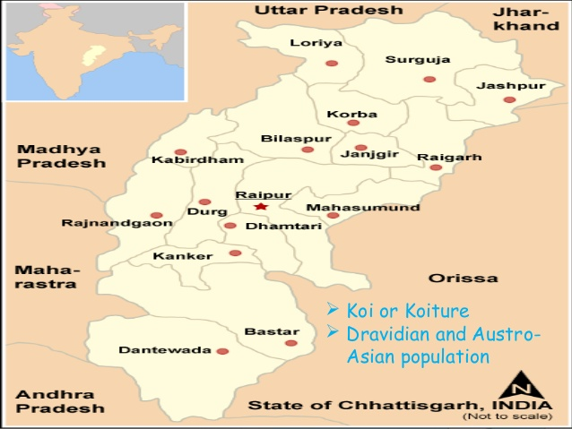

Slide 13
To be continued

