Slide 1
Ppt for Geography Hons part2,paper4,unit 1,sectionA,topic:Temperate grassland ,Date13/05/20
By Rhicha jyotsna
Assistant professor geography
M.l Arya College kasba
Purnea University,Purnia

Slide 2


Slide 3
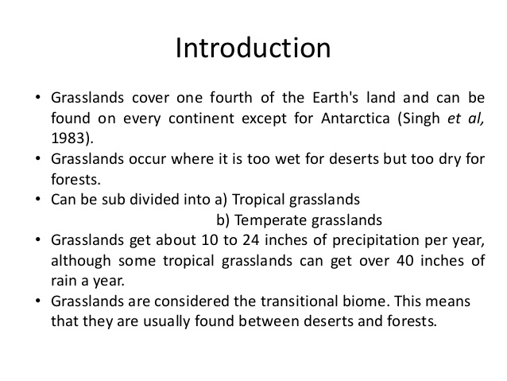

Slide 4
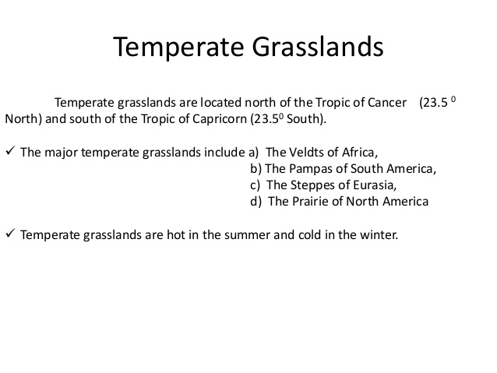

Slide 5
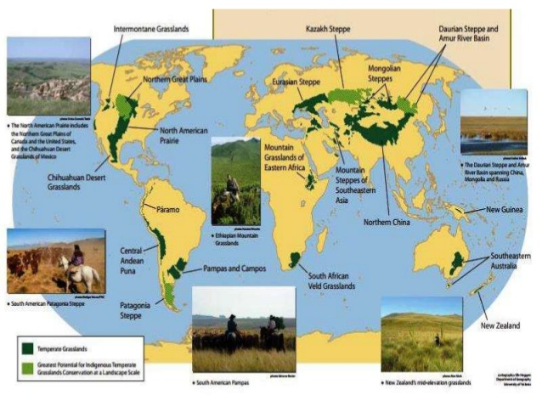

Slide 6
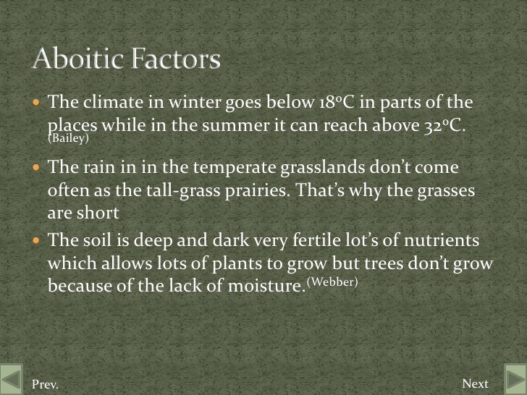

Slide 7
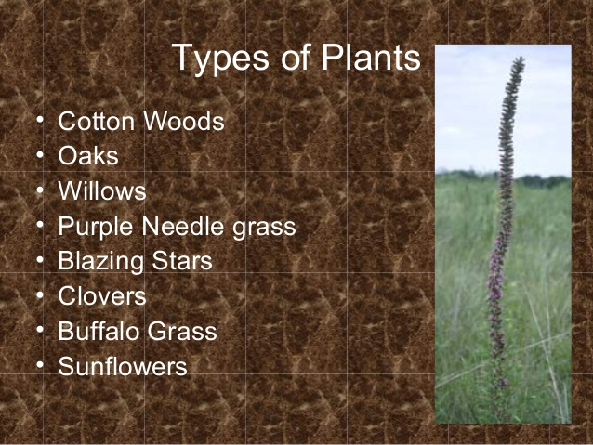

Slide 8
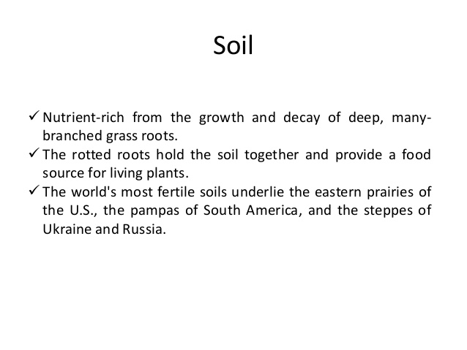

Slide 9
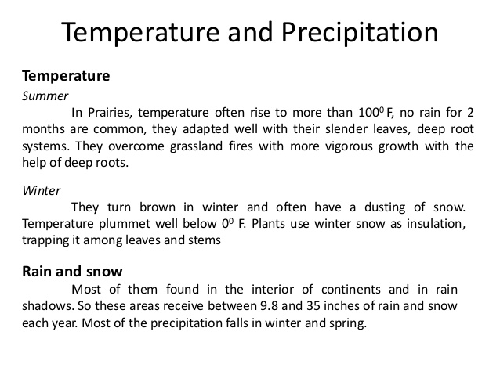

Slide 10
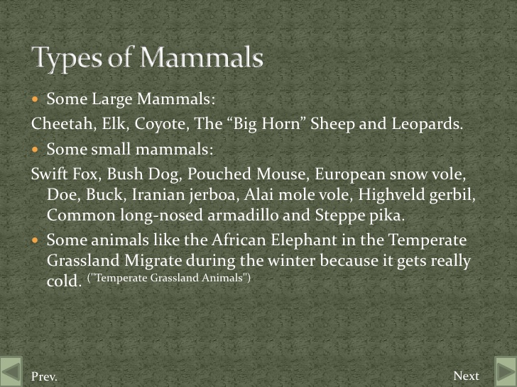

Slide 11
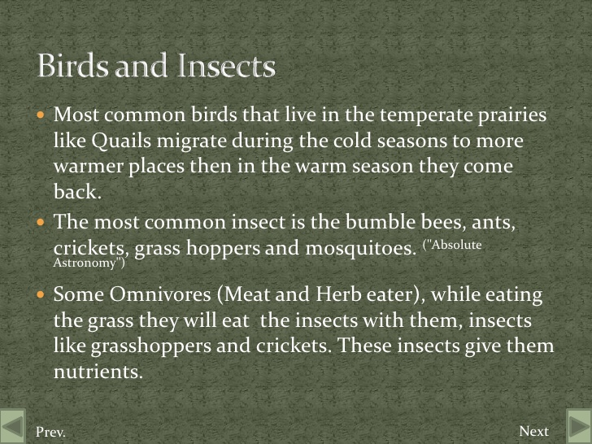

Slide 12
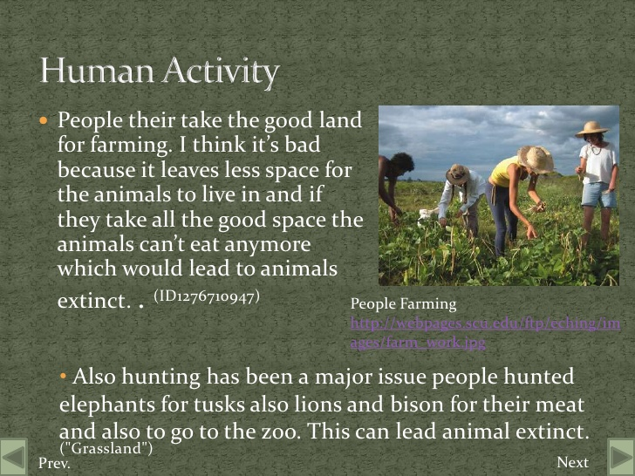

Slide 13
To be continued

