Slide 1
Ppt for Geography Hons part2,paper4,unit 1,sectionA,topic:Temperate grassland ,Date13/05/20
By Rhicha jyotsna
Assistant professor geography
M.l Arya College kasba
Purnea University,Purnia

Slide 5
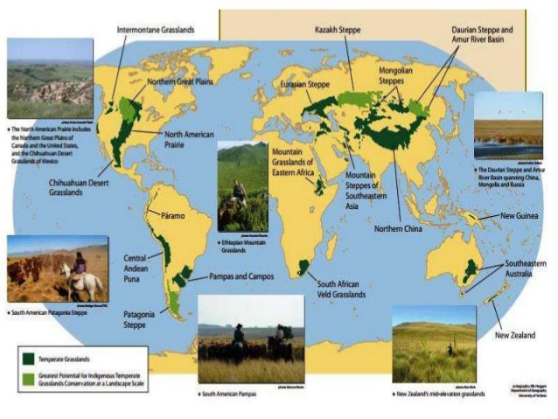

Slide 13
To be continued

