Slide 1
Ppt for geography(Hons)part2,paper 4,unit1,Section A,Topic:Desert environment Date:18/05/20
By
Rhicha jyotsna
Assistant professor geography
M.l Arya college kasba

Slide 8
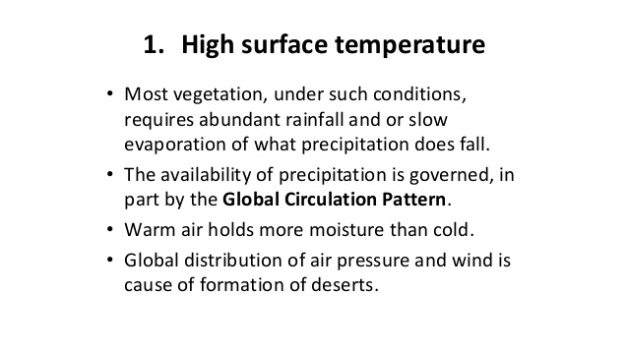

Slide 12
To be continued

