Slide 1
Ppt for Geography(Hons)part2, paper4,section b,unit 4,topic:World Population Date:04/05/20
By
Rhicha Jyotsna
Assistant Professor Geography
M.l Arya College kasba
Purnea University ,purnia

Slide 2
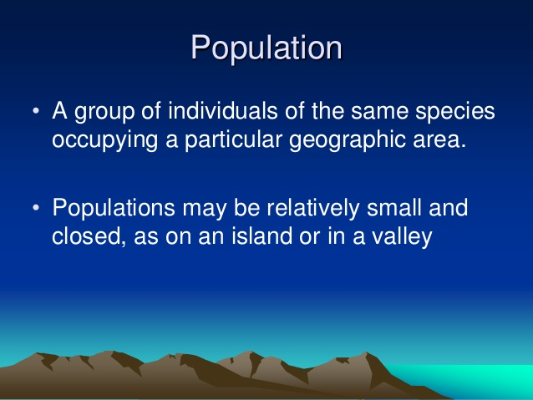

Slide 3
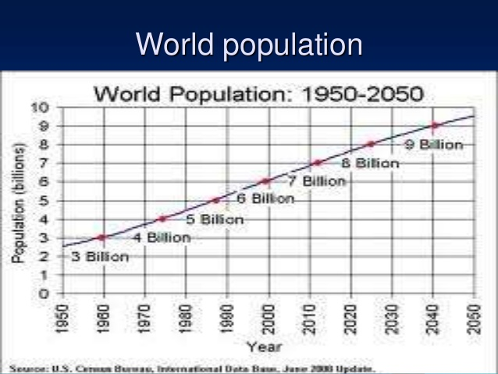

Slide 4
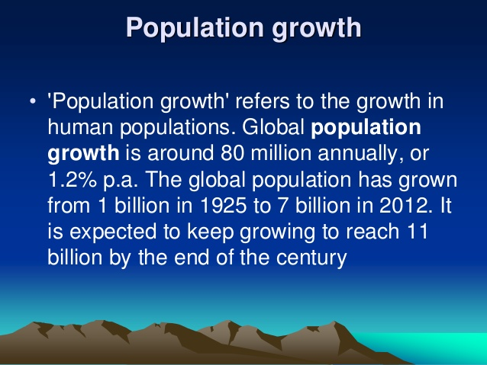

Slide 5
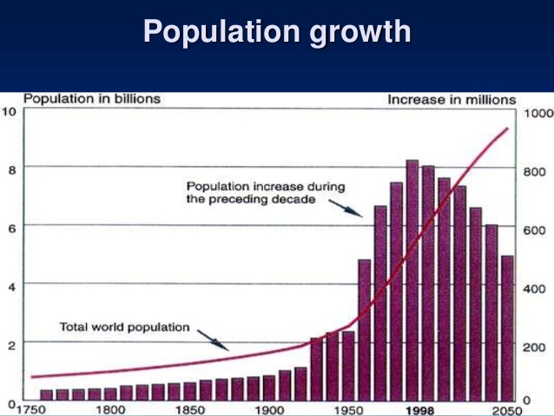

Slide 6
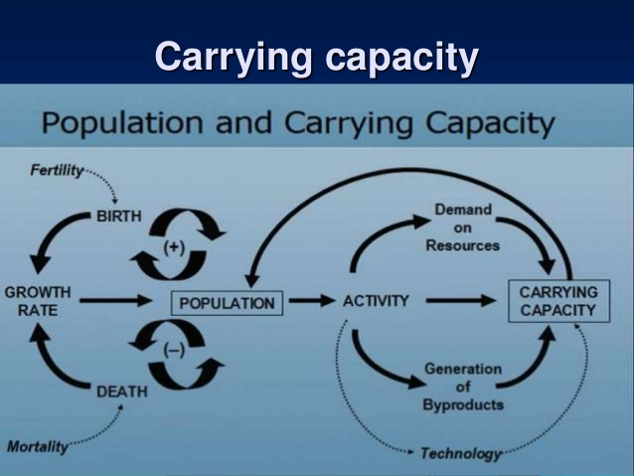

Slide 7
