Slide 1
Real Analysis Lecture-4 Sequence Dated:-16.05.2020 PPT-13 UG (B.Sc., Part-2)
Dr. Md. Ataur Rahman
Guest Faculty
Department of Mathematics
M.L. Arya, College, Kasba
PURNEA UNIVERSITY, PURNIA

Slide 2
Bounded Sequence
Bounded above :- Any sequence is said to be bounded above if there exists a number k such that
Where the number k is called the upper bound of the sequence
Example
So, is bounded above and 1 is called upper bound of the sequence

Slide 3
Bounded Sequence
Bounded below :- Any sequence is said to be bounded below if there exists a number h such that
Where the number h is called the lower bound of the sequence
Example
So, is bounded below and 0 is called lower bound of the sequence

Slide 4
Bounded Sequence
Definition :- Any sequence is said to be bounded if there exists two numbers h and k such that
Where h is called the lower bound and k is called upper bound of the sequence
Example
is a bounded sequence,

Slide 5
Least upper bound (L.u.p)
Definition:- Any sequence is said to be have least upper bound if there exists a number k such that
then the number k is called the least upper bound of the sequence
Example
So, here 1 is called least upper bound of the sequence

Slide 6
Greatest Lower bound (G.l.b)
Definition:- Any sequence is said to be have greatest lower bound if there exists a number h such that
then the number h is called the greatest lower bound of the sequence
Example
So, here o is called greatest lower bound of the sequence

Slide 7
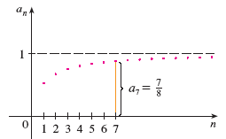
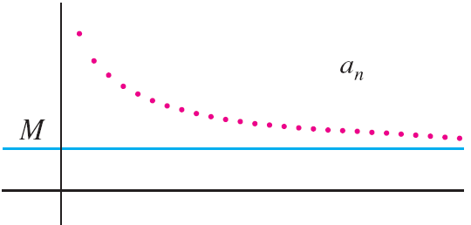
BOUDED SEQUENCES
DEFINITION
If M is an upper bound but no number less than M is an upper bound then M is the least upper bound.
DEFINITION
If m is a lower bound but no number greater than m is a lower bound then m is the greatest lower bound
bounded from above
bounded from below
Upper bound
Lower bound
Example
Example
Is bounded below
greatest upper bound = ??
Is bounded above by any number greater than one
If is bounded
from above and below,
If is not bounded
we say that
Least upper bound
bounded
unbounded

Slide 8
Examples
Determine if the the sequence is bounded or not.

