Slide 1
Real Analysis Lecture-1 Sequence Dated:-11.05.2020 PPT-07 UG (B.Sc., Part-2)
Dr. Md. Ataur Rahman
Guest Faculty
Department of Mathematics
M.L. Arya, College, Kasba
PURNEA UNIVERSITY, PURNIA

Slide 2
Contents
Sequences
Types of Sequences
Convergent, Divergent and Oscillatory Sequences
Bounded sequence
Monotonic sequence
Cauchy Sequence
Cauchy’ general Principle of convergence
Continuity and Differentiability
Properties of Continuous &discontinuous functions

Slide 3
Sequence
Definition (1):- A sequence is an ordered list of objects whose terms can be expressed by general formula.
i.e. The arrangement of real numbers whose term can be expressed by general formula.
Definition (2):- A sequence is mapping whose domain is the set of natural numbers.
Domain: 1, 2, 3, 4, ……..n…
Range a_{1,} a_{2,} a_{3,} a_{4, ….. ……}a_{n…}

Slide 4
Examples
Write a general formula for the nth term of the following sequences

Slide 5
Types of Sequences
Convergent Sequence
Divergent Sequence
Oscillatory Sequence
Monotonic Sequence
(i)Monotonic increasing Sequence
(ii)Monotonic decreasing Sequence
(5) Bounded Sequence
(i) Bounded above
(ii) Bounded below

Slide 6
Convergent Sequence
Definition:-A Sequence is said to be convergent if
Example1

Slide 7
Convergent Sequence
Example 2

Slide 8
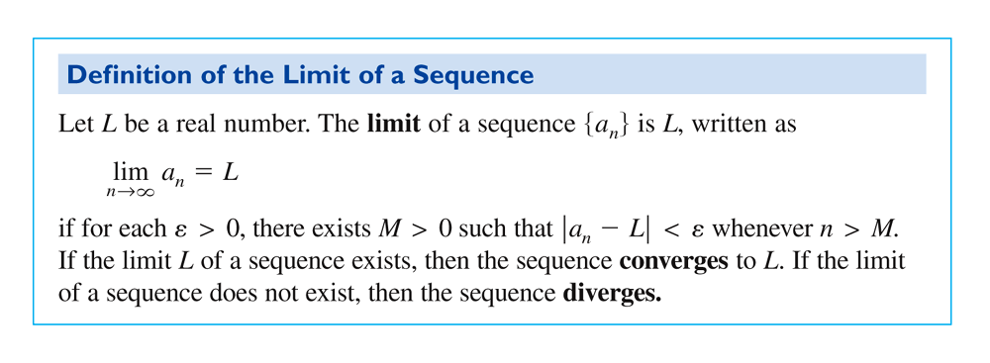
Limit of a Convergent Sequence

Slide 9
Sequences
Write the first 5 terms of the sequence.
Does the sequence converge? If so, find the value.
The sequence is convergent and converges to 0.
The sequence diverges.

Slide 10
Write the first 5 terms for and show that the sequence is convergent.
As a function
On a number line
The terms in this sequence get closer and closer to 1. The sequence CONVERGES to 1.

Slide 11
Write the terms for a_{n} = 3
Since a_{n} = 3 is a constant. Therefore, The terms of the above sequence are 3, 3, 3, …3,….
Then the sequence is convergent and converges to 3.

Slide 12
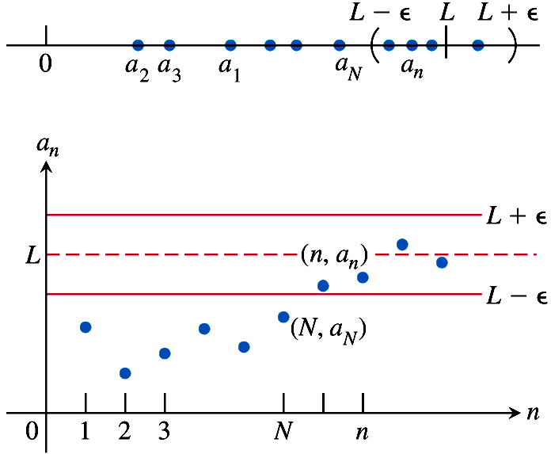
y= L is a horizontal asymptote when sequence converges to L.

