Slide 1
Real Analysis Lecture-3 Sequence Dated:-15.05.2020 PPT-12 UG (B.Sc., Part-2)
Dr. Md. Ataur Rahman
Guest Faculty
Department of Mathematics
M.L. Arya, College, Kasba
PURNEA UNIVERSITY, PURNIA

Slide 2
Monotonic Sequence
Monotonic increasing Sequence:-A sequence
is said to be monotonic increasing if
Then is called strictly monotonic increasing.
Monotonic decreasing Sequence:-A sequence
is said to be monotonic decreasing if
Then is called strictly monotonic decreasing.

Slide 3
Monotonic Sequence
Definition:--A sequence is said to be a monotonic sequence if it is either monotonic increasing or monotonic decreasing.
i.e. if either of the following conditions are satisfied

Slide 4
Examples
Let
2. Let

Slide 5
MONOTONIC SEQUENCE
DEFINITION 1
is non-decreasing if
DEFINITION 2
is non-increasing if
DEFINITION 3
is monotonic sequence
if it is either non-increasing or non-decreasing.

Slide 6
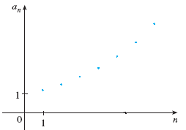
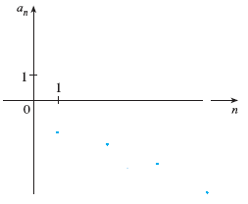
MONOTONIC SEQUENCES
DEFINITION
is non-decreasing (increasing) if
DEFINITION
is non-increasing (decreasing)

Slide 7
Examples
1. Is the sequence increasing or decreasing
2. Is the sequence increasing or decreasing

