Slide 1
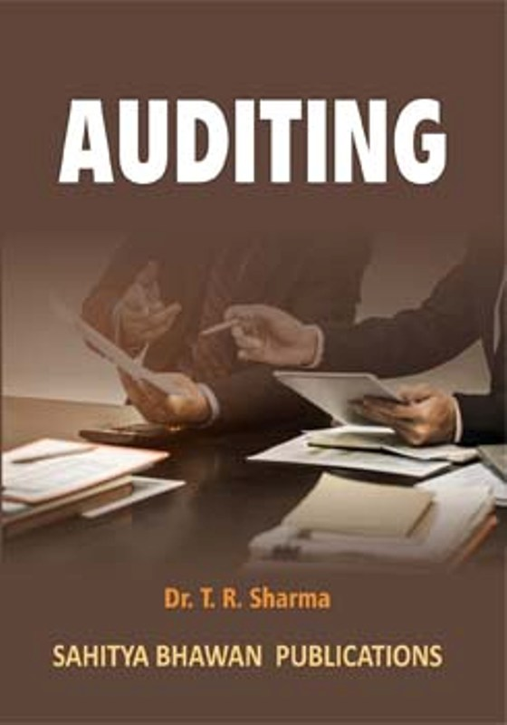
BY JAHANAVI DEO
DEPARTMENT OF COMMERCE
M.L ARYA COLLEGE, KASBA
B.COM 1_UNIT 5_DATE:09/05/2020

Slide 2
PRINCIPLES OF VOUCHING
9. Revenue Stamp:
The auditor should also check that voucher bears a required revenue stamp or not?
10. Case Of Cancelled Voucher:
The auditor should not accept the cancelled voucher. Because it has already served the purpose of payment. There will be a danger of double payment if it is accepted.

Slide 3
11. Important Notes:
The auditor should take some important notes about those items which need further evidence or explanation.
12. Payment:
The auditor should check that whether payment is described partially or for complete transaction of sale.

Slide 4
13. Agreements:
These provide the basic information to the auditor. He should check the agreements, correspondence and other relevant papers.
14. Printer Vouchers:
Printer vouchers are considered true and these are legally acceptable. If these are not printed then these are useless.
15. List Of Missing Vouchers:
Auditor should prepare the list of missing vouchers. This list will be helpful in detecting the fraud and errors.

