Slide 1
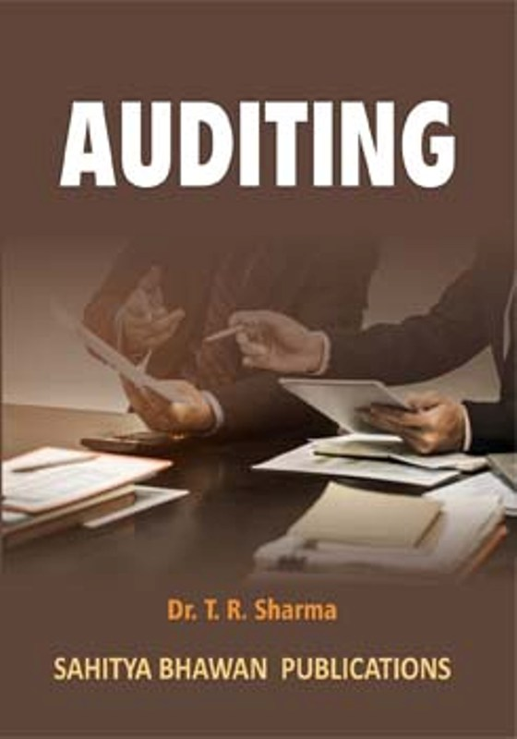
BY JAHANAVI DEO
B.COM 1
DEPARTMENT OF COMMERCE
M.L ARYA COLLEGE, KASBA

Slide 2
Principles or Techniques of Vouching:
At the time of vouching auditor should keep in view the following important principles in his mind :

Slide 3
1. Arranged Vouchers:
First of all auditor should check all the vouchers provided by the client are properly arranged. These are in the same order as the entries are made in the books.
2. Checking Of Date:
The auditor should compare the date of the voucher with he date recorded in the cash book.

Slide 4
3. Compare The Words And Figures :
The auditor should satisfy himself amount written numbered consecutively. All the vouchers should be properly filed. On the vouchers, its figures and words are same or not.
4. Checking Of Authority:
The auditor should examine that all the vouchers are passed by the authorized officer. If the voucher is passed by unauthorized person it will not be correct.

Slide 5
5. Cutting Or Change:
If there is any cutting or change on the receipts and vouchers figures it should be signed by the authorized officer. The auditor should satisfy himself by inquiring about it.
6. Transaction Must Relate To Business:
The auditor should carefully examine that the entries must relate to the business.

Slide 6
7. Case Of Personal Vouchers:
The auditor should not accept the voucher in personal name. There is a chance that an officer of the company has purchased any item in his personal capacity.
8. Checking Of Account Head:
Auditor must be satisfied about the head of account on which cash is deposited and drawn. He should examine the documentary evidence in this regard.

