Slide 1
BY JAHANAVI DEO
B.COM 1
DEPARTMENT OF COMMERCE
M.L ARYA COLLEGE, KASBA

Slide 2
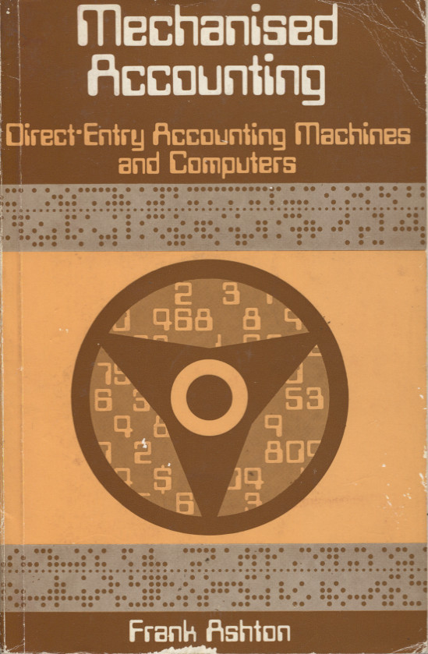
MECHANISED ACCOUNTING
In the traditional manual system of accounting, a lot of steps were involved in recording the Accounting transactions. In the present day business scenario a lot of information can be fetched in very less time, without spending a lot of workforce and resources. Therefore, various machines are doing the work of recording and presenting accounting transactions.

Slide 3
Advantages of Mechanized Accounting
It saves time and cost in recording accounting transactions.
Machines works very efficiently, hence chances of errors are reduced.
It enhances speed of work.
Accounting through machines is neat and legible.
Without any delay final accounts can be prepared any time.

Slide 4
Cost of internal control system and Internal Check can be minimized.
Desired number of copies of any record is easily available.
Past year's data and record can be reproduced in desired form without any delay.

Slide 5
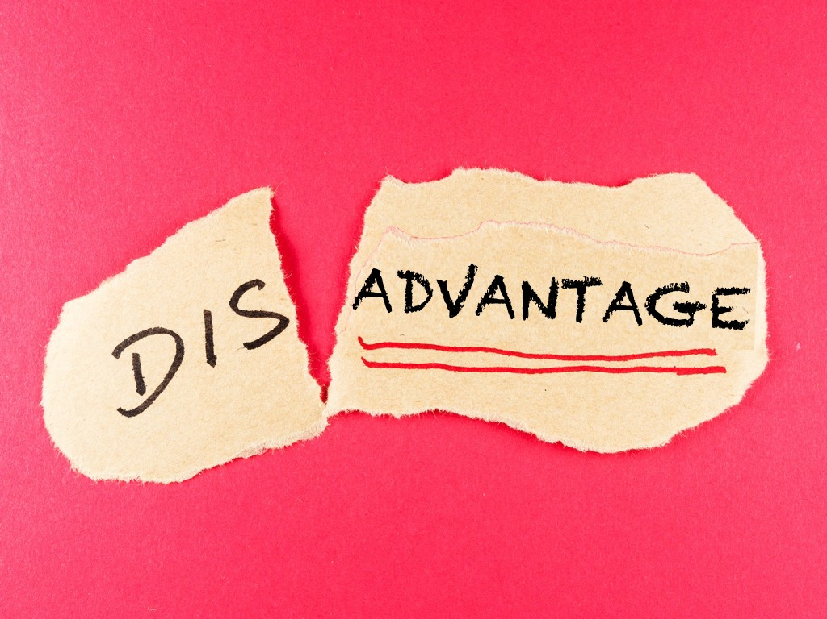
Disadvantages of Mechanized Accounting
Wrong punching of data at initial stage will produce wrong results.
Loose cards and sheets maintained under it are not acceptable by court.
It is very difficult to locate and rectify error in it.

Slide 6
Mechanized Accounting and Auditor
An Auditor should consider the following points while conducting audit of mechanized accounting records −
He must verify original data punching.
Scrutiny of internal control system is must.
He must ensure that actual and authorized accounting transactions shall be recorded.
He must obtain explanation, if any, required in any entry.
He requires certificate whether machines are in order and working properly or no

