Slide 1

BY JAHANAVI DEO
DEPARTMENT OF COMMERCE
M.L ARYA COLLEGE, KASBA
B.COM 1_UNIT 3_DATE-27/05/2020

Slide 2
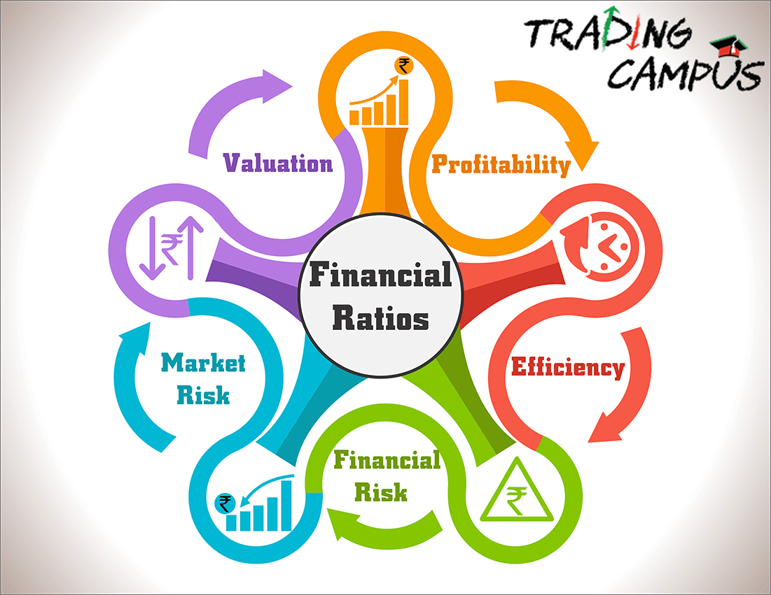
Ratio analysis

Slide 3


Slide 4
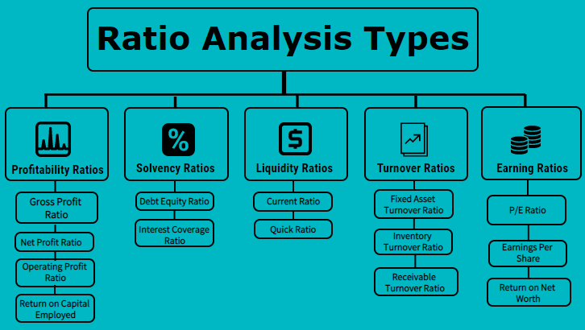

Slide 5
Liquidity ratios:
Liquidity refers to a company's ability to pay its current bills and expenses. In other words, liquidity relates to the availability of cash and other assets to cover accounts payable, short-term debt, and other liabilities.
All small businesses require a certain degree of liquidity in order to pay their bills on time, though start-up and very young companies are often not very liquid. In mature companies, low levels of liquidity can indicate poor management or a need for additional capital.
Of course, any company's liquidity may vary due to seasonality, the timing of sales, and the state of the economy. This is the most fundamentally important set of ratios, because they measure the ability of a company to remain in business.

Slide 6
➢ Cash coverage ratio: Shows the amount of cash available to pay interest.
➢ Current ratio: Measures the amount of liquidity available to pay for current liabilities.
➢ Quick ratio: The same as the current ratio, but does not include inventory.
➢ Liquidity index: Measures the amount of time required to convert assets into cash.

Slide 7
Activity ratios:
These ratios are a strong indicator of the quality of management, since they reveal how well management is utilizing company resources.
➢ Accounts payable turnover ratio: Measures the speed with which a company pays its suppliers.
➢ Accounts receivable turnover ratio: Measures a company's ability to collect accounts receivable.
➢ Fixed asset turnover ratio: Measures a company's ability to generate sales from a certain base of fixed assets.
➢ Inventory turnover ratio: Measures the amount of inventory needed to support a given level of sales.
➢ Sales to working capital ratio: Shows the amount of working capital required to support a given amount of sales.
➢ Working capital turnover ratio: Measures a company's ability to generate sales from a certain base of working capital.

