Slide 1
BY JAHANAVI DEO
DEPARTMENT OF COMMERCE
M.L ARYA COLLEGE,KASBA
B.COM 2_DATE:18/05/2020

Slide 2
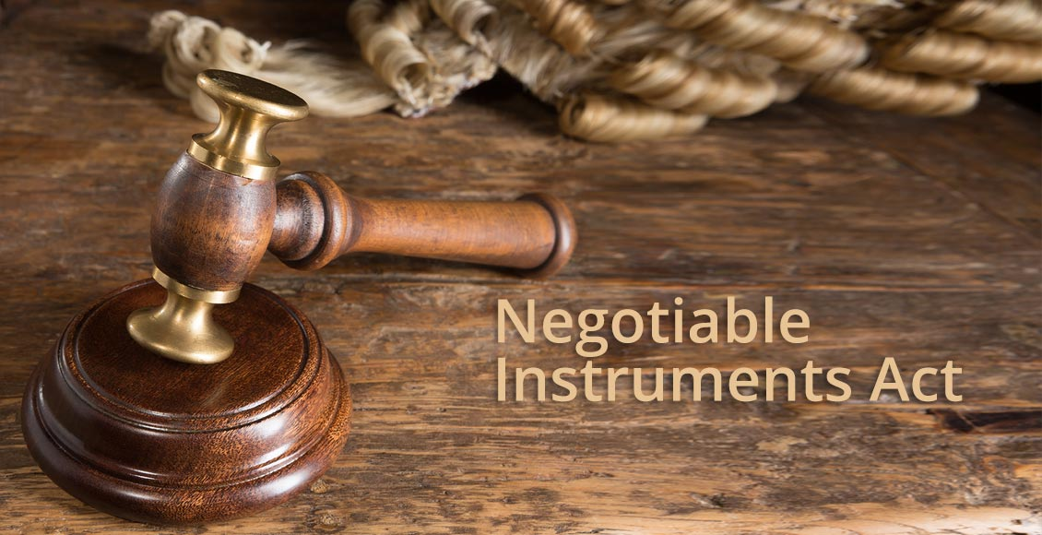
Negotiable instrument act, 1981
The Act has not defined negotiable instruments clearly but it has provided an inclusive meaning for them.
Section 13(1) says NIs include promissory notes, bills of exchange or cheques payable either to order or to bearer. Hence, the Act only includes these three types of NIs within its ambit.

Slide 3
A negotiable instrument is nothing but a document. Some laws and definitions also treat it as movable property.
Since every property has some monetary worth, even NIs possess some financial value. In order to purchase it, one just has to pay its value to its owner and acquire it as property.
According to these definitions, an instrument of this kind must always possess the following characteristics:
It should be freely transferable either by simple delivery or by endorsement and delivery.
Defects in the title of sellers of these instruments do not affect persons who purchase them in good faith.
Holders of these instruments can sue upon them in their own names.

Slide 4
CHARACTERISTICS OF A NEGOTIABLE INSTRUMENT
1. Property:
The prossessor of the negotiable instrument is presumed to be the owner of the property contained therein. A negotiable instrument does not merely give possession of the instrument but right to property also. The property in a negotiable instrument can be transferred without any formality. In the case of bearer instrument, the property passes by mere delivery to the transferee. In the case of an order instrument, endorsement and delivery are required for the transfer of property.

Slide 5
2. Title:
The transferee of a negotiable instrument is known as ‘holder in due course.’ A bona fide transferee for value is not affected by any defect of title on the part of the transferor or of any of the previous holders of the instrument.

Slide 6
3. Rights:
The transferee of the negotiable instrument can sue in his own name, in case of dishonour. A negotiable instrument can be transferred any number of times till it is at maturity. The holder of the instrument need not give notice of transfer to the party liable on the instrument to pay.

Slide 7
4. Presumptions:
Certain presumptions apply to all negotiable instruments e.g., a presumption that consideration has been paid under it. It is not necessary to write in a promissory note the words ‘for value received’ or similar expressions because the payment of consideration is presumed. The words are usually included to create additional evidence of consideration.

Slide 8
5. Prompt payment:
A negotiable instrument enables the holder to expect prompt payment because a dishonour means the ruin of the credit of all persons who are parties to the instrument

Slide 9
Effect of Negotiability
One of the most important principles relating to property transfers is ‘nemo dat quad non-habet’. This maxim basically means nobody can pass a better title than that he himself possesses.
In other words, one cannot transfer anything that does not belong to him in the first place. The effect of this rule is that any transfer without the transferor’s title is null and void.
Negotiable instruments are common exceptions to this very important rule requiring a proper title for transfers. Hence, a person may validly acquire NIs from a seller who does not possess a title over them. This only requirement of this exception is that the purchase of NIs must be for bona fide reasons.

