Slide 1
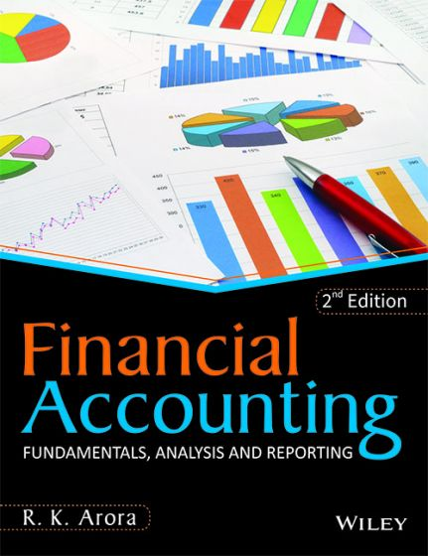
BY JAHANAVI DEO
DEPARTMENT OF COMMERCE
M.L ARYA COLLEGE, KASBA
B.COM1_UNIT 2_DATE:19/05/2020

Slide 2
FINANCIAL STATEMENTS USED IN FINANCIAL ANALYSIS
Income Statement
The Profit & Loss Account reveals financial result in term of Net Profit or Net loss for the period of account year which is normally 12 months.
Items appearing on Debit side of the Profit & Loss Account:
The Expenses incurred in a business is divided in two parts. i.e; one is Direct expenses are recorded in trading Account., and another one is indirect expenses, which are recorded on the debit side of profit & loss account.

Slide 3
Indirect Expenses are grouped under four heads:
Selling Expenses: All expenses relating to sales such as Carriage outwards, travelling expenses, Advertising etc.
Office Expenses: Expenses incurred on running an office such as Office Salaries, Rent, Tax, Postage, Stationery etc.,
Maintenance Expenses: Maintenance expenses of assets. It includes Repairs and Renewals, Depreciation etc
.
Financial Expenses: Interest Paid on loan, Discount allowed etc., are few examples for Financial Expenses.

Slide 4
Item appearing on Credit side of Profit and Loss account: Gross Profit is appeared on the credit side of P & L. account. Also other gains and incomes of the business are shown on the credit side. Typical of such gains are items such as Interest received, Rent received, Discounts earned, Commission earned.

Slide 5
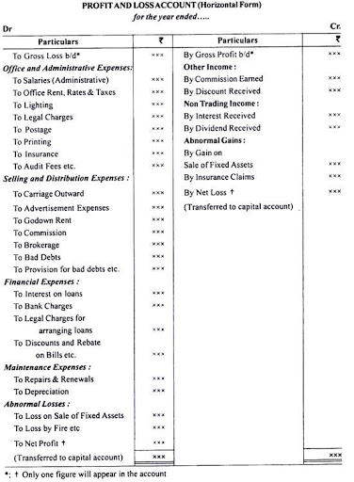

Slide 6
Balance Sheet
The accounting balance sheet is one of the major financial statements used by accountants and business owners. (The other major financial statements are the income statement, statement of cash flows, and statement of stockholders' equity).
The balance sheet is also referred to as the statement of financial position.

Slide 7
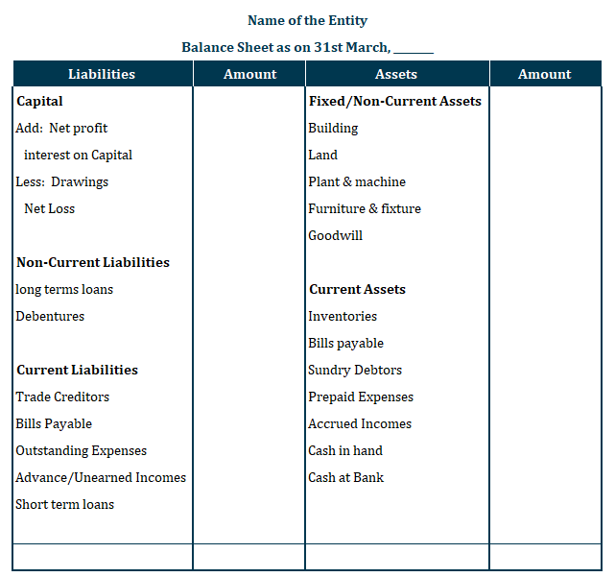

Slide 8
The balance sheet presents a company's financial position at the end of a specified date. Some describe the balance sheet as a "snapshot" of the company's financial position at a point (a moment or an instant) in time.
For example, the amounts reported on a balance sheet dated December 31, 2012 reflect that instant when all the transactions through December 31 have been recorded. Because the balance sheet informs the reader of a company's financial position as of one moment in time, it allows someone like a creditor to see what a company owns as well as what it owes to other parties as of the date indicated in the heading.
This is valuable information to the banker who wants to determine whether or not a company qualifies for additional credit or loans. Others who would be interested in the balance sheet include current investors, potential investors, company management, suppliers, some customers, competitors, government agencies, and labor unions

Slide 9


