Slide 1
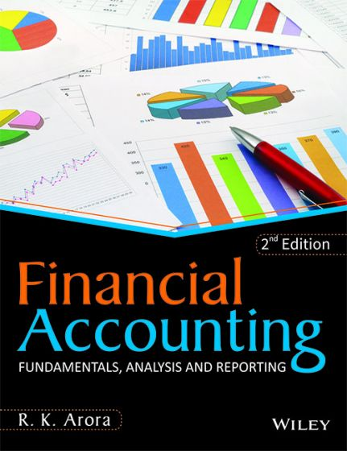
BY JAHANAVI DEO
DEPARTMENT OF COMMERCE
M.L ARYA COLLEGE, KASBA
B.COM1_UNIT 2_DATE:21/05/2020

Slide 2
Components of balance sheet
We will begin our explanation of the accounting balance sheet with its major components, elements, or major categories:
➢ Assets
➢ Liabilities
➢ Owner's (Stockholders') Equity

Slide 3
Assets
Assets are things that the company owns. They are the resources of the company that have been acquired through transactions, and have future economic value that can be measured and expressed in dollars. Assets also include costs paid in advance that have not yet expired, such as prepaid advertising, prepaid insurance, prepaid legal fees, and prepaid rent.

Slide 4
Classifications of Assets on the Balance Sheet Accountants usually prepare classified balance sheets. "Classified" means that the balance sheet accounts are presented in distinct groupings, categories, or classifications. The asset classifications and their order of appearance on the balance sheet are:
➢ Current Assets
➢ Investments
➢ Property, Plant, and Equipment
➢ Intangible Assets
➢ Other Assets

Slide 5
Liabilities
Liabilities are obligations of the company; they are amounts owed to creditors for a past transaction and they usually have the word "payable" in their account title.
Along with owner's equity, liabilities can be thought of as a source of the company's assets. They can also be thought of as a claim against a company's assets.

Slide 6
Classifications of Liabilities on the Balance Sheet
Liability and contra liability accounts are usually classified (put into distinct groupings, categories, or classifications) on the balance sheet. The liability classifications and their order of appearance on the balance sheet are:
➢ Current Liabilities
➢ Long Term Liabilities
➢ Owner's (Stockholders') Equity

Slide 7
Owner's Equity—along with liabilities—can be thought of as a source of the company's assets. Owner's equity is sometimes referred to as the book value of the company, because owner's equity is equal to the reported asset amounts minus the reported liability amounts. Owner's equity may also be referred to as the residual of assets minus liabilities. These references make sense if you think of the basic accounting equation:
Assets = Liabilities + Owner's Equity
and just rearrange the terms:
Owner's Equity = Assets – Liabilities
"Owner's Equity" are the words used on the balance sheet when the company is a sole proprietorship. If the company is a corporation, the words Stockholders' Equity are used instead of Owner's Equity.

Slide 8
Classifications of Owner's Equity on the Balance Sheet
Owner's equity is generally represented on the balance sheet with two or three accounts (e.g., Mary Smith, Capital; Mary Smith, Drawing; and perhaps Current Year's Net Income). See the sample balance sheet in Part 4. The stockholders' equity section of a corporation's balance sheet is:
➢ Paid-in Capital
➢ Retained Earnings
➢ Treasury Stock

