Slide 1
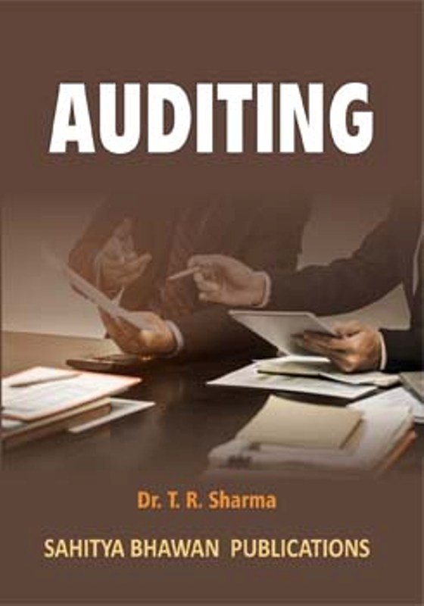
BY JAHANAVI DEO
DEPARTMENT OF COMMERCE
M.L ARYA COLLEGE, KASBA
B.COM 1_DATE-14/05/2020

Slide 2
QUESTION-ANSWER SESSION
1. Which of the following is normally the most reliable source of audit evidence? (a). Internal audit (b). Suppliers’ statements (c). Board minutes (d). Analytical review

Slide 3
2. Which of the following is NOT a main element of a purchases system? (a). Placing orders (b). Receiving purchase invoices (c). Goods received (d). Decisions at board level on whether to incur capital expenditure

Slide 4
3. According to ISA 500, the strength of audit evidence is determined by which two qualities? (a). Appropriateness & competence (b). Sufficiency & appropriateness (c). Reliability & extensiveness (d). Objectivity & independence

Slide 5
4. Which of the following are you unlikely to see in the current file of auditors’ working papers? (a). Memorandum & articles of association (b). Audit planning memorandum (c). Summary of unadjusted errors (d). Details of the work done on the inventory count

Slide 6
8. Assuming that it is not the first appointment of the auditor, who is responsible for the appointment of the auditor? (a).The shareholders in a general meeting (b). The managing director (c). The board of directors in a board meeting (d). The audit committee

Slide 7
5. International auditing standards are issued by the: (a).International Accounting Standards Board (b). Financial Accounting Standards Board (c). International Audit and Assurance Standards Board (d). Auditing Practices Board

