Slide 1
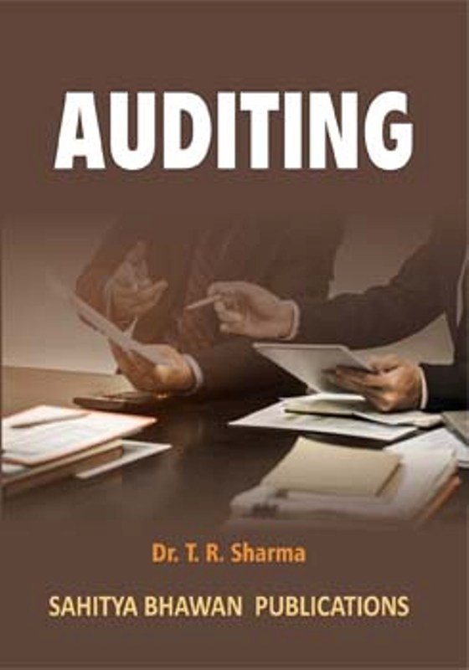
BY JAHANAVI DEO
B.COM 1
DEPARTMENT OF COMMERCE
M.L ARYA COLLEGE, KASBA

Slide 2
QUESTION-ANSWER SESSION
Internal check is carried on by___________?
A. Staff specially appointed for the purpose B. Internal auditor C. Supervisor of the staff D. Members of the staff

Slide 3
The process of distribution of work among employees according to their ability is known as:
A. Internal audit
B. Internal control
C. Internal check
D. None of these

Slide 4
The main object of internal check is:
A. To find out errors and fraud
B. To examine accounts
C. To distribute the duties among employees
D. To verify assets

Slide 5
The best medium of payment is:
A. Cash
B. Bank
C. Bills
D. None of these

Slide 6
Which method is suitable for recording of wages:
A. Wage register
B. Wage schedule
C. Wage cards
D. None of these

Slide 7
The universal principle of purchases is:
A. Best goods
B. Cheapest goods
C. Best and cheapest goods
D. None of these

