Slide 1

B.COM 1
Unit 3
BY JAHANAVI DEO
DEPARTMENT OF COMMERCE
M.L ARYA COLLEGE,KASBA

Slide 2
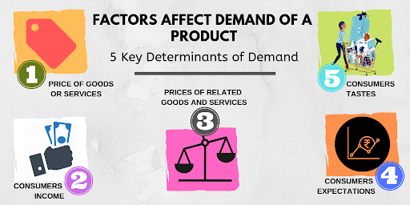

Slide 3
D(X)= F ( P, R, Y, T, E)
D(X) = quantity demanded of a commodity x
P(X)= own price of commodity x
P(R)= price of related goods
Y = consumers income
T = consumer’s tastes and preferences
E = consumer’s expectations

Slide 4
Price of the product:
Changes in the price of the of the commodity will lead to changes in the quantity demanded.
Income of the consumer:
A change in real income means that there is a change in the quantity of goods and services money income can buy. For most goods , an increased in real income will lead to an increase in demand.
Normal goods:
Goods for which demand increases when income increases are called normal goods.
In facts, there exists a direct relationship between income and quantity demanded for it.

Slide 5
Inferior goods:
the goods for which demand decreases as income increases , are called
inferior goods.
Tastes , habits and preferences:
demand depends on the individual’s taste which is controlled and influenced by advertising and sales promotion. A change in consumer tastes in favour of a good can increase the demand for that commodity. This may be attributed to a successful advertising campaign. Similarly, if a commodity is infashion , demand will rise.

