Slide 1
BY JAHANAVI DEO
DEPARTMENT OF COMMERCE
M.L ARYA COLLEGE, KASBA
B.COM 1_UNIT 3_DATE:14/05/2020

Slide 2
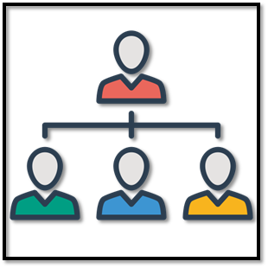
Advantages of line organization
1. Simplicity:
It is very simple to establish and operate. It can be easily understood by the employees.
2. Fixed responsibility:
Duties and responsibilities are clearly defined for each individual with reference to the work assigned to him. As a result everybody knows to whom he is responsible and who are responsible to him. Nobody can avoid responsibility.

Slide 3
3. Discipline:
This type of organisation ensures better discipline in the enterprise. Singleness of responsibilities facilitates discipline in the organisation. The workers at the lower levels will be more loyal and responsible to one single boss rather than to a number of bosses.
4. Flexibility:
It is flexible in the sense that it is subject to quick adjustments to suit to changing conditions. In the words of Wheeler, “It permits rapid and orderly decisions in meeting problems at various levels of organisation”. In simple words, it is more adaptive to the changed circumstances.

Slide 4
5. Co-ordination:
It helps to achieve effective co- ordination. All the activities pertaining to single department are controlled by one person.
6. Direct communication:
As there will be direct communication between the superior and the subordinates at different levels it would be helpful in achieving promptness in performance.

Slide 5
7. Unity of command:
Every worker is accountable to one boss in the department under this type of organisation. In this manner it is in accordance with the principle of unity of command.
8. Economical:
It is not complex and expensive. It is simple and economical in operation. It does not need any expert and specialised personnel.

Slide 6
9. Quick decisions:
On account of its simple operation and unified control and responsibility, decisions can be taken promptly. The process of decision-making is further quickened as the decision is taken by one person.
10. Executive development:
Under this organisation, the department head is fully responsible for every activity in his department. He discharges his responsibilities in an efficient manner. He comes across many problems and obstacles in performing his duties.

Slide 7
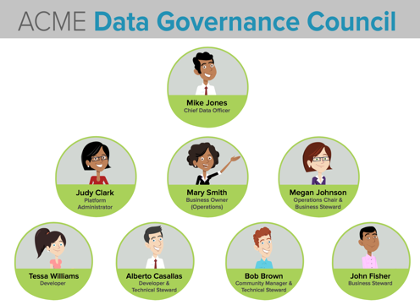
DISADVANTAGES OF LINE ORGANISATION
1. Overloading:
The main disadvantage of this system is that it tends to overload the existing executive with too many responsibilities. The work may not be performed effectively on account of innumerable tasks before the single executive.
2. Lack of specialization:
Absence of managerial specialisation is the major drawback of this system. On account of many functions and complexities it is very difficult for a single individual to control all the matters effectively.
The executive may not be expert in all aspects of managerial activities. The burden of responsibilities on the shoulders of the manager can crush him under the heavy workload.
3. Scope for favoritisms:
There may be a good deal of favouritism and nepotism under this type of organization. As the concerned officer will judge the performance of the persons at work according to his own norms, it is possible that efficient people may be left behind and inefficient or ‘yes men’ may get higher and better posts.

Slide 8
4. Lack of co-ordination:
In reality it is very difficult to achieve proper co­ordination among various departments operating in an organisation. This is because each departmental manager or head carries the functioning of his department in accordance with the ways and means suitable to him.
This leads to lack of uniformity in operation among various departments which is detrimental in achieving proper co­ordination in the overall functioning of the various departments operating in the organisation.
5. Lack of initiative:
Under line organization, ultimate authority lies in the hands of top management and departmental managers or heads have little powers. This adversely affects their initiative and enthusiasm to motivate the subordinates working under them.
6. Lack of communication from lower ranks:
Under line organisation suggestions move from down to upwards the superiors usually do not pay attention to suggestions sent by lower ranks. This leads to inadequacy of communication from subordinates to superiors.

