Slide 1
MODERN THEORY OF WAGES
Dolly Kumari
Department of Economics
M.L.Arya College, Kasba, Purnia
Class- B.A part-1
Paper-1
30-04-20

Slide 6
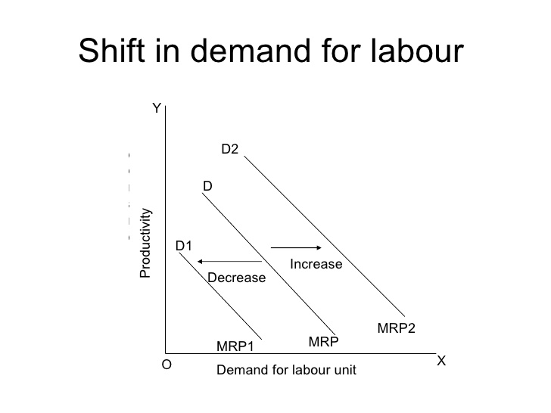

Slide 8
