Slide 1
Ppt for Geography(Hons) part 2,paper 4 ,section B Unit 3 Topic:Eskimos
By
Rhicha jyotsna
Assistant professor(Geography)
M.l Arya College kasba
Purnea University,purnia

Slide 2
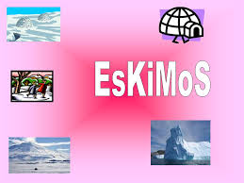

Slide 5
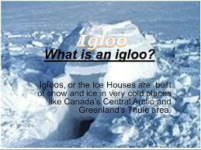

Slide 6
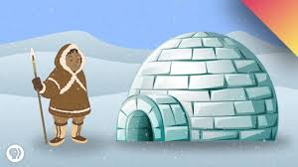

Slide 9
The Inuit are the descendants of what anthropologists call the Thule culture, a nomadic people who emerged from western Alaska around 1000 and spread eastwards across the Arctic, displacing the related Dorset culture (in Inuktitut, the Tuniit). Inuit legends speak of the Tuniit as "giants", people who were taller and stronger than the Inuit, but who were easily scared off and retreated from the advancing Inuit. By 1300, the Inuit had settled west Greenland, and finally moved into east Greenland over the following century.

Slide 10
Clothing consisted of coat, trousers, stockings, shoes or boots. In very cold weather two of each garment were worn. The inner one had the fur against the skin, the outer one had the fur outside. Boots are called kamiks. They are made from sealskin because it lasts long, is warm, and isn't hurt when it gets wet.

Slide 12
The end

