Slide 1
Ppt for (Geography)part2,paper1,sectionB,unit4 Topic:Salinity of ocean and sea Date:20/04/20
By
Rhicha jyotsna
Assistant professor(Geography)
M. L Arya College kasba
Purnea University,Purnia

Slide 3
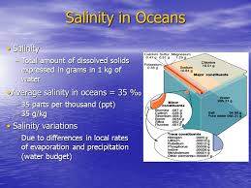

Slide 7
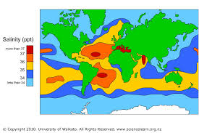

Slide 12
The end

