Slide 1
Ppt for Geography(Hons)part 2,paper1,sectionA,unit 2 Topic:Atmospheric Humidity Date:16/04/20
By
Rhicha jyotsna
Assistant professor(Geography)
M.l Arya College kasba
Purnea University,purnia

Slide 5
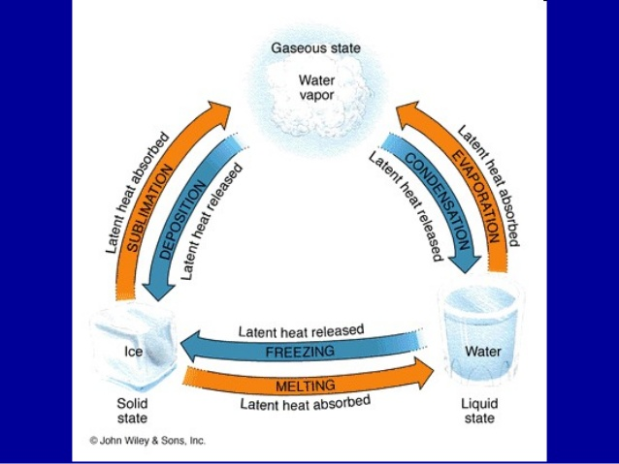

Slide 9
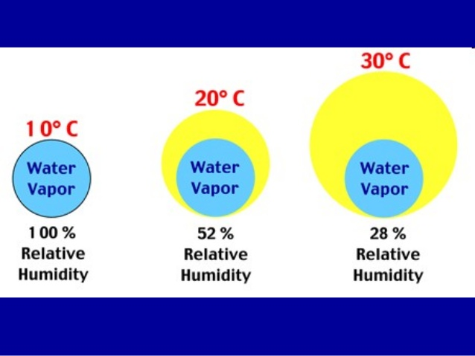

Slide 10
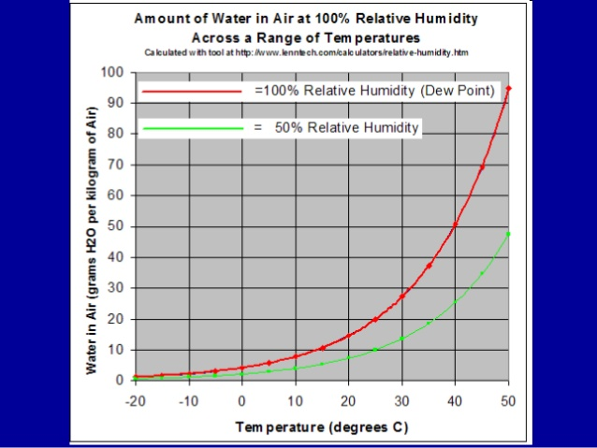

Slide 13
The end

