Slide 1
Physics
Numericals Part 5
Topics: General Properties of Matter/ Electrodynamics
Course: B.Sc/ Physics
Dr. Rajesh Kumar Neogy
Assistant Professor, Physics
M. L. Arya College, Kasba
Purnea University, Purnia, Bihar

Slide 2
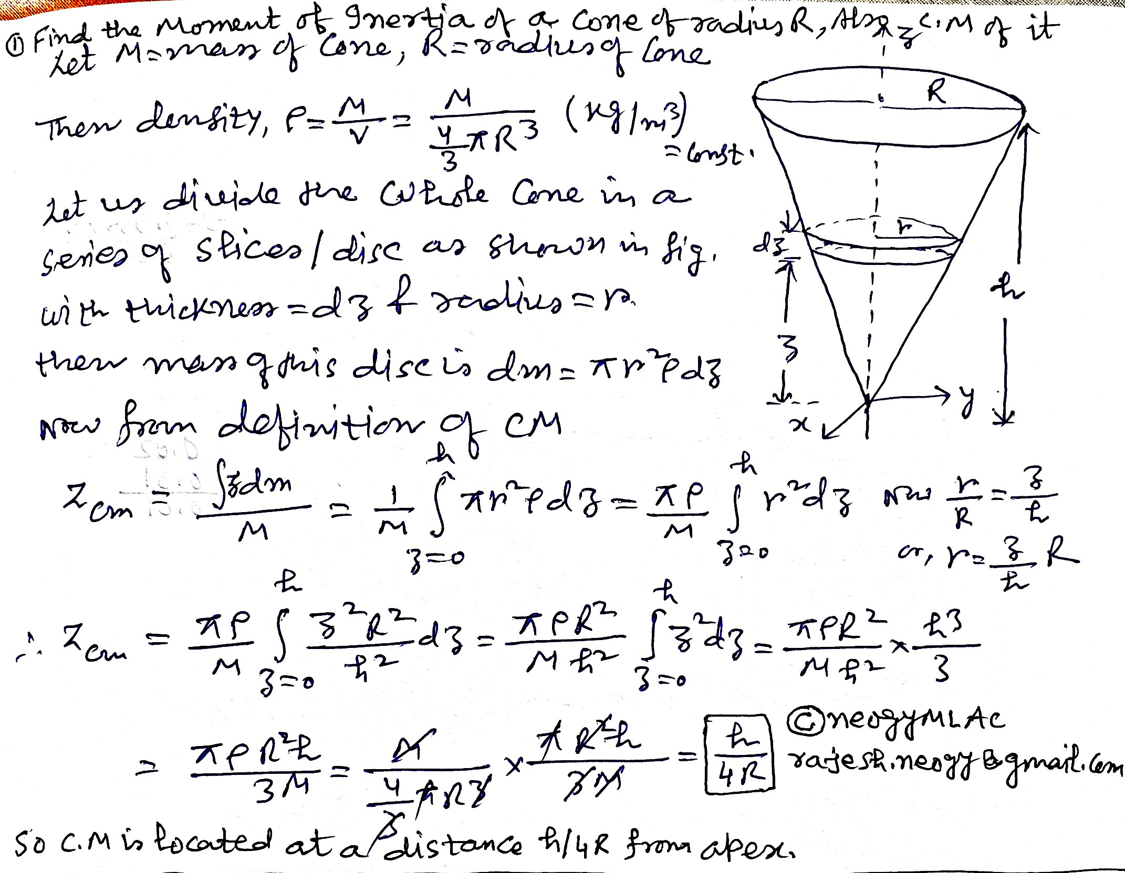

Slide 3
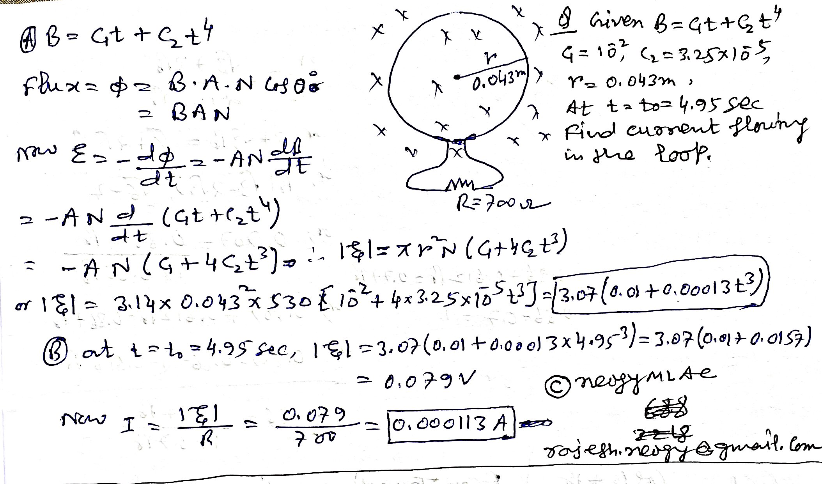

Slide 4
For any queries feel free to contact me at Email: Rajesh.neogy@gmail.com
These study materials are meant only for personal use and no commercial/ Publication use etc.
Thanksss

