Slide 1
2 D Co-ordinate Geometry
Lecture-9
Parabola
UG (B.Sc., Part-1)
By
Dr. Md. Ataur Rahman
Guest Faculty
Department of Mathematics
M.L. Arya, College, Kasba
PURNEA UNIVERSITY, PURNIA

Slide 2
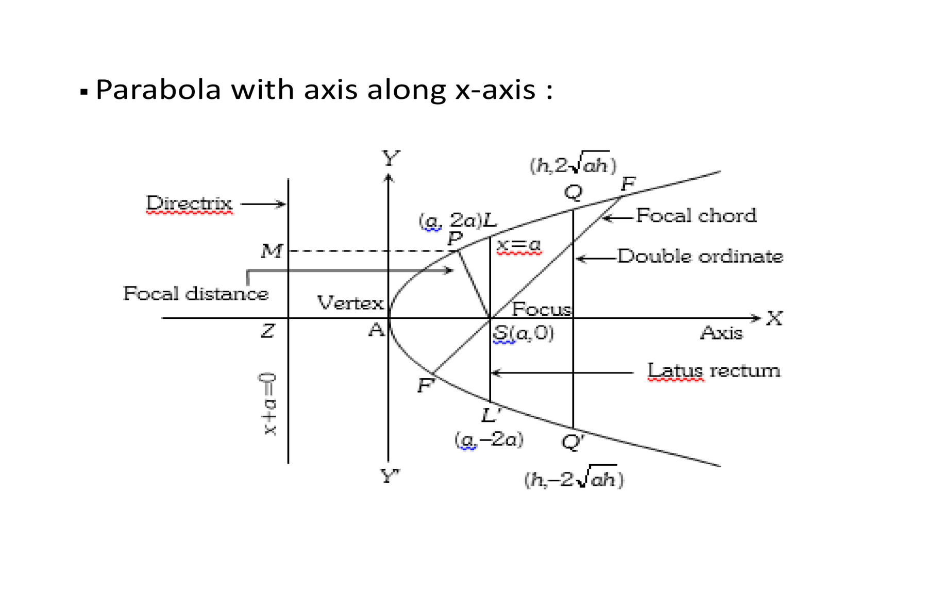
Important terms related to Parabola

Slide 3
Important terms related to Parabola
Axis of Parabola:-The line passing through the focus and perpendicular to the directrix is called axis of parabola.
In the above given figure,
the line ZS is the axis of parabola.
Vertex:-The point of intersection of the parabola and axis of parabola is called its vertex.
In the above given figure,
A is the vertex of parabola.

Slide 4
Important terms related to Parabola
Chord:- The line segment joining any two points on the parabola is chord of the parabola.
Focal chord:-The chord passing through the focus focus (S) is called focal chord of the parabola.
In the given figure, PQ is a focal chord.
Focal distance:- The distance of any point on the parabola from the focus is called focal distance of the parabola. i.e PS is the focal distance.

Slide 5
Important terms related to Parabola
Latus rectum:-A chord passing through the focus and perpendicular to the axis of parabola is latus rectum of the parabola.
In the given figure,
LL’ is the latus rectum.
Doule ordinate:- A chord perpendicular to the axis of parabola is called axis of the parabola.

Slide 6
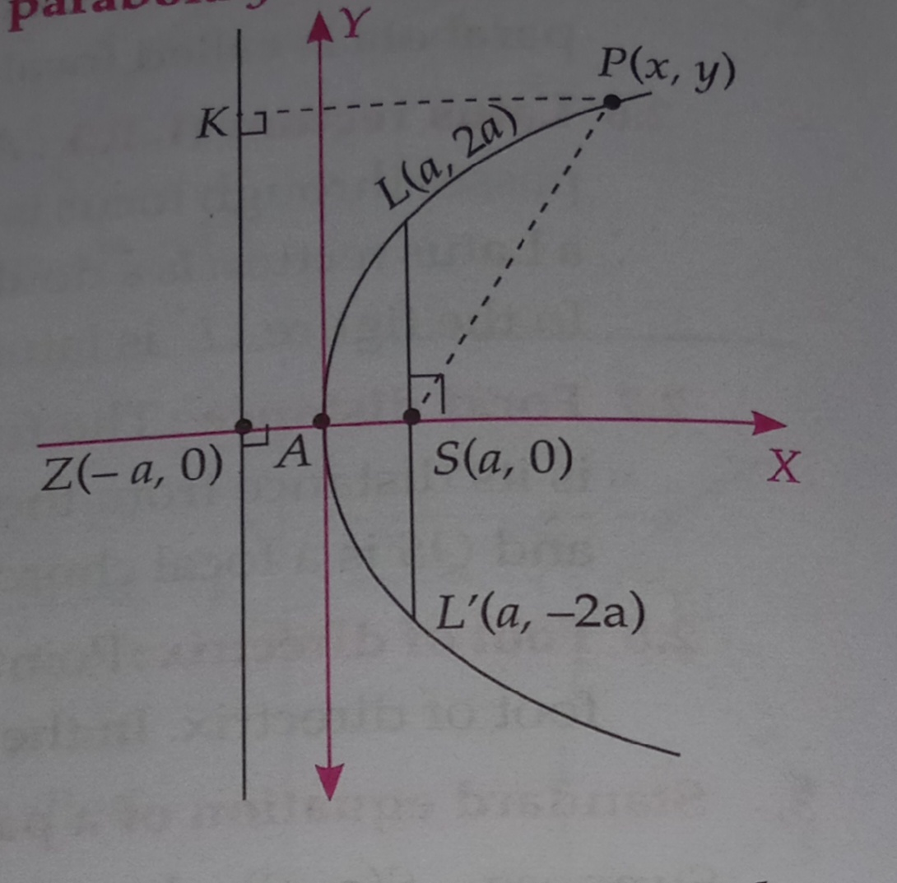

Slide 7
Explanation of

Slide 8
Explanation of
1. Focus
2. Vertex
3. Equation of directrix
Since Z (-a,0), then
4. Axis of parabola
Since x-axis is perpendicular to the directrix.
5. Tangent at the vertex:- y-axis i.e x=0

Slide 9
Explanation
6. End points of Latus rectum:-
7. Length of latus rectum
and its equation is
8. Focal distance from any point P(x,y)

