Slide 1
PHYSICS
B.Sc Part I
Dr. Rajesh Kumar Neogy
Assistant Professor
Dept. Of Physics
M. L Arya College kasba

Slide 2
Laws of Thermodynamics
Thermodynamics
• Thermodynamics is the study of the effects of work, heat, and energy on a system
• Thermodynamics is only concerned with macroscopic (large-scale) changes and observations

Slide 3
Getting Started
• All of thermodynamics can be expressed in terms of four quantities
(i) Temperature (T)
(ii) Internal Energy (U)
(iii) Entropy (S)
(iv) Heat (Q)
• We will take up and discuss all these quantities as we progress through the lesson

Slide 4
Introduction According to British scientist C. P. Snow, the three laws of thermodynamics can be (humorously) summarized as
1. You can’t win
2. You can’t even break even
3. You can’t get out of the game

Slide 5
1.0 You can’t win (1st law)
• The first law of thermodynamics is an extension of the law of conservation of energy
• The change in internal energy of a system is equal to the heat added to the system minus the work done by the system ΔU = Q - W

Slide 6
Definitions
In our study of thermodynamics, we will choose a small part of the universe to which we will apply the laws of thermodynamics. We call this subset a SYSTEM.
The thermodynamic system is analogous to the free body diagram to which we apply the laws of mechanics, (i.e. Newton’s Laws of Motion).
The system is a macroscopically identifiable collection of matter on which we focus our attention (eg: the water kettle or the aircraft engine).

Slide 7
The rest of the universe outside the system close enough to the system to have some perceptible effect on the system is called the surroundings.
The surfaces which separates the system from the surroundings are called the boundaries as shown in fig below (eg: walls of the kettle, the housing of the engine).
Closed system - in which no mass is permitted to cross the system boundary i.e. we would always consider a system of constant mass. We do permit heat and work to enter or leave but not mass.
Open system- in which we permit mass to cross the system boundary in either direction (from the system to surroundings or vice versa). In analysing open systems, we typically look at a specified region of space, and observe what happens at the boundaries of that region.
Isolated System - in which there is no interaction between system and the surroundings. It is of fixed mass and energy, and hence there is no mass and energy transfer across the system boundary.

Slide 8
Zeroth Law Of Thermodynamics (Contd…)
Two systems are said to be equal in temperature, when there is no change in their respective observable properties when they are brought together. In other words, “when two systems are at the same temperature they are in thermal equilibrium” (They will not exchange heat).
Explanation of Zeroth Law
Let us say T _{A},T_{B} and T_{C} are the temperatures of A,B and C respectively.
A and c are in thermal equilibrium. T_{a}= t_{c}
B and C are in thermal equilibrium. T_{b}= t_{c}
Consequence of of ‘0’th law
A and B will also be in thermal equilibrium T_{A}= T_{B}
Looks very logical
All temperature measurements are based on this LAW.

Slide 9
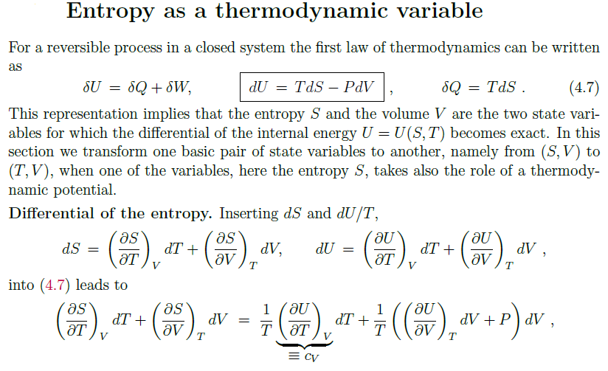

Slide 10
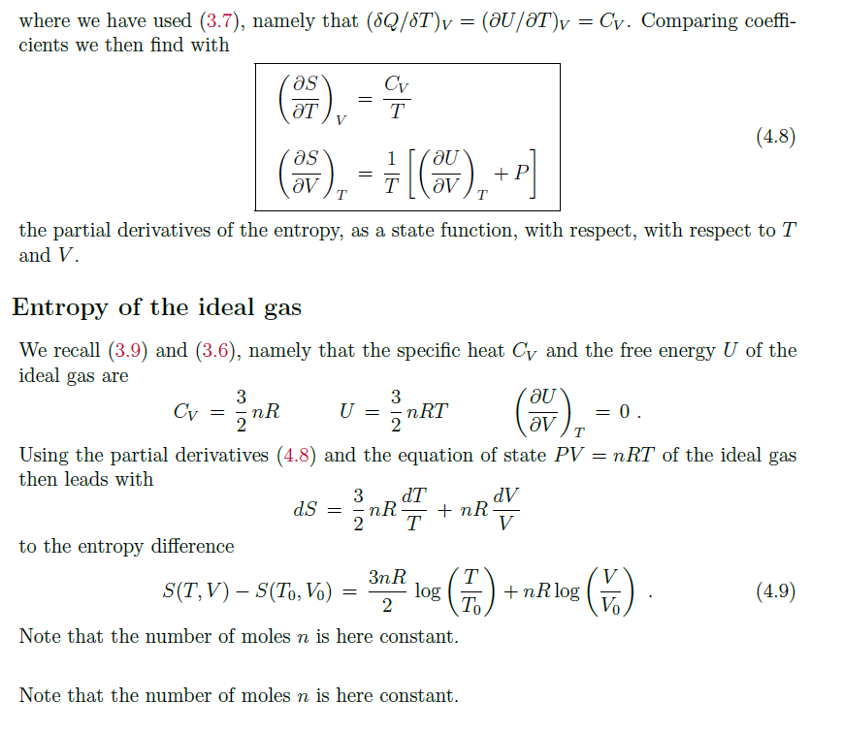

Slide 11
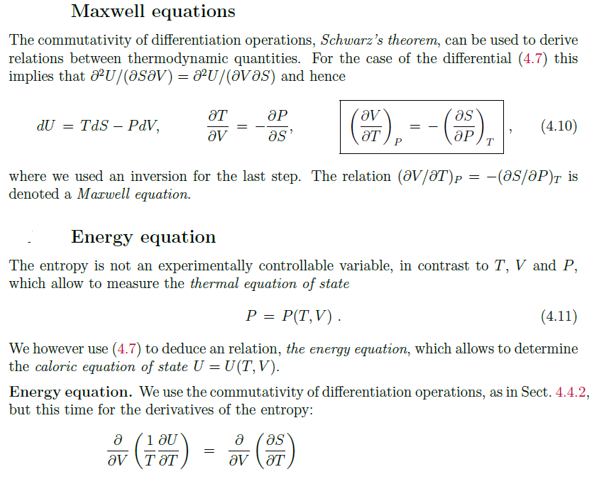

Slide 12
