Slide 1
B.COM 1
Unit 3
BY JAHANAVI DEO
DEPARTMENT OF COMMERCE
M.L ARYA COLLEGE,KASBA

Slide 3
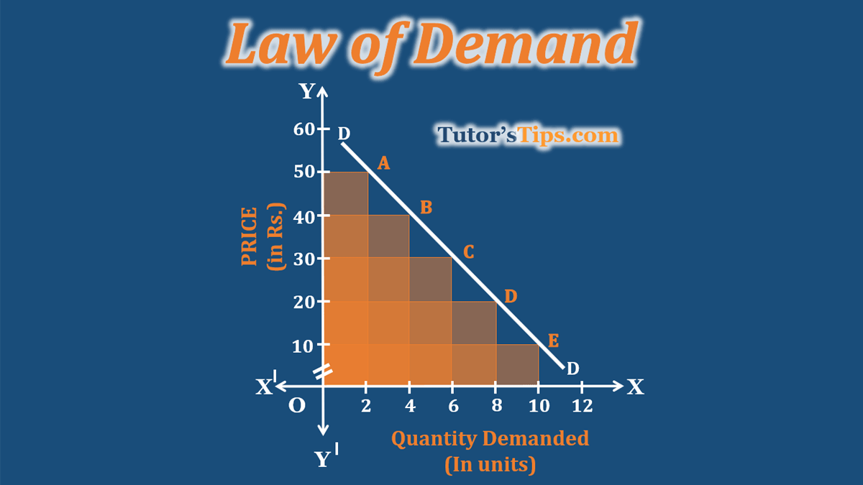
Law of demand
If other things being constant, the higher the price of the commodity the smaller is the quantity demanded and lower the price, larger the quantity demanded.
There is inverse relationship between price and commodity.

Slide 6
Assumptions of law of demand
No change in consumer’s income
No change in consumer’s preference
No change in fashion
No change in the price of related goods
No expectation of future price changes or shortages
No change in government policy etc.

Slide 7
Exceptions to the law of demand.
Veblan goods
giffen goods
Time of war n depression

