Slide 1

BY JAHANAVI DEO
DEPARTMENT OF COMMERCE
M.L ARYA COLLEGE,KASBA

Slide 2
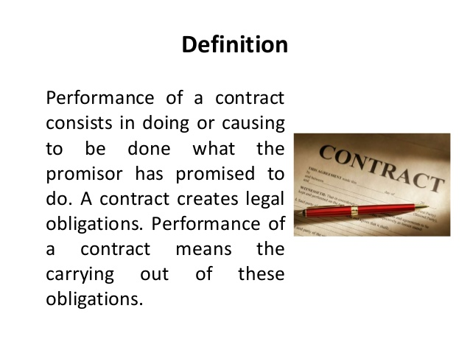

Slide 3
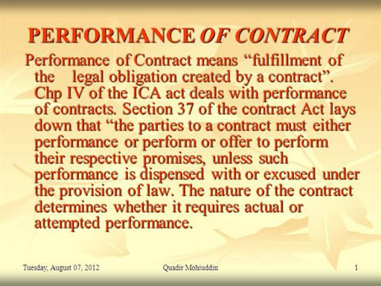

Slide 4
Performance of contract
Duties of seller and buyer.-
It is the duty of the seller to deliver the goods and of the buyer to accept and pay for them, in accordance with the terms of the contract of sale
Payment and delivery are concurrent conditions.- Unless otherwise agreed, delivery of the gods and payment of the price are concurrent conditions, that is to say, the seller shall be ready and willing to give possession of the goods to the buyer in exchange for the price, and the buyer shall be ready and willing to pay the price in exchange for possession of the goods.

Slide 5
. Delivery.- Delivery of goods sold may be made by doing anything which the parties agree shall be treated as delivery or which has the effect of putting the goods in the possession of the buyer or of any person authorised to hold them on his behalf.
Effect of part delivery.- A delivery of part of goods, in progress of the delivery of the whole has the same effect, for the purpose of passing the property in such goods, as a delivery of the whole, but a delivery of part of the gods, with an intention of severing it from the whole, does not operate as a delivery of the remainder
Buyer to apply for delivery.- Apart from any express contract, the

Slide 6
Delivery of wrong quantity.-
(1) Where the seller delivers to the buyer a quantity of good less than he contracted to sell, the buyer may reject them, but if the buyer accepts the goods so delivered he shall pay for them at the contract rate.
(2) Where the seller delivers to the buyer a quantity of goods larger than he contracted to sell the buyer may accept the goods included in the contact and reject the rest, or he may reject the whole. If the buyer accepts the whole of the goods so delivered, he shall pay for them at the contract rate.
(3) Where the seller delivers to the buyer the gods he contract to sell mixed with goods of a different description not included in the contract., the buyer may accept the goods which are in accordance with the contract and reject the rest, or may reject the whole. (4) The provisions of this section are subject to any usage of trade, special agreement.

