Slide 1
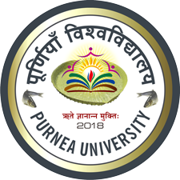
Gold
Course Instructor: Dr. Atul Kumar Singh
Assistant Professor
Department of Chemistry
M. L. Arya College, Kasba
Purnia -854330
India

Slide 2
Extraction of Mineral gold
Extraction of Gold from mineral in which gold is present in a combined state.
Mineral is subjected to roasting in order to remove easily oxidizable impurities like sulphur, tellurium, arsenic, antimony etc.
The roasted ore is then subjected to the MacArthur-forest cyanide process or Plattner’s chlorine process.

Slide 3
A. MacArther-forest cyanide process
This process is based on the fact that gold dissolves in alkali potassium cyanide in the presence of air or oxygen due to formation of cyanide complex
In this process finely powdered roasted ore is filled in a large vats made of cement or iron consisting of false wooden bottoms with holes.

Slide 4
A solution of potassium cyanide (0.5%) percolates all through for 12-24 hours to form the cyanide complex.
The metal gold is precipitated by zinc shavings.

Slide 5
B. Plattner’s Chlorine Process
In this process finely powdered roasted ore is filled in a large vats with false bottoms, then moistened and saturated with current of chlorine from underneath and left for 24 hour.
The gold chloride formed from the reaction of chlorine is leached with water.
The solution is transferred to a separate tank

Slide 6
where it is treated with ferrous sulphate to precipitate gold.

Slide 7
Thank you

