Slide 1
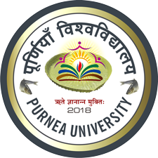
Gold
Course Instructor: Dr. Atul Kumar Singh
Assistant Professor
Department of Chemistry
M. L. Arya College, Kasba
Purnia -854330
India

Slide 2
Occurrence:
Metallic gold, which is found free in nature, has always been valued for its nobility, i.e. its resistance to chemical attack.
Gold occurs in native state either scattered in sand and gravel or mixed in quartz.
The mineral sylvanite contain a telluride of silver and gold [(Au, Ag)Te₂ ]

Slide 3
Metallurgy of Gold
According to the nature of gold source different method are adopted for extraction of gold
Extraction of Alluvial or Placer Gold
Extraction of Vein Gold
Extraction of Mineral Gold

Slide 4
Extraction of Alluvial or Placer Gold
Extraction of Gold from mixed with sand, gravel or silt.
Gold is separated by taking advantage of its higher specific gravity (19.3) form sand, gravel or silt.

Slide 5
Extraction of Vein Gold
Extraction of Gold from hard auriferous quartz rocks.

Slide 6
1. Pulverization

Slide 7
2. Amalgamation

Slide 8
3. distillation
Gold amalgam is squeezed between rubber block and distilled in iron resorts.
Mercury distils over while gold is left in the retorts.
gold particle recovered from the retort are fused with a flux like borax .
On cooling converted in to solid lump or bar

Slide 9
4. Recovery of gold from Tailings
Tailing contain 20-25% of gold.
The tailing are again passed over amalgamated plates.
15-20 % gold recovered and 10-20% escape in to gangue.
5. Treatment of gangue
The remaining 10-15% 0f gold is extracted from the gangue with the help of the MacArthur- Forest cyanide process.

Slide 10
Thank you

