Slide 1
M.L Arya College (Purnea University, Purnia)
Digital Classes for B.Sc I Physics
Session: 2019-2020
Course Instructor: Dr. Rajesh Kumar Neogy
(rajesh.neogy@gmail.com)
(Assistant Professor)
Department of Physics
M. L Arya College, Kasba

Slide 2
PHOTOELECTRIC EFFECT AND DUAL NATURE OF MATTER AND RADIATIONS
Photons
Photoelectric Effect
Experimental Set-up to study Photoelectric Effect
Effect of Intensity, Frequency, Potential on P.E. Current
Graphical representation of variation of P.E. Current
Laws of Photoelectric Effect
Einstein’s Photoelectric Equation
Verification of Laws of Photoelectric Effect based on Einstein’s Photoelectric Equation
Application of Photoelectric Effect
Matter Waves and de Broglie wavelength
Davission & Germer Experiment

Slide 3
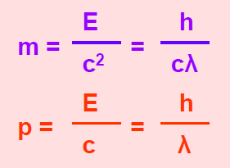
Photon: A packet or bundle of energy is called a photon. Energy of a photon is E = hν = hc/λ where h is the Planck’s constant, ν is the frequency of the radiation or photon, c is the speed of light (e.m. wave) and λ is the wavelength.
Properties of photons:
i) A photon travels at a speed of light c in vacuum. (i.e. 3 x 10^(-8) m/s)
ii) It has zero rest mass. i.e. the photon can not exist at rest.
iii) The kinetic mass of a photon is
iv) The momentum of a photon is,
v) Photons travel in a straight line.
vi) Energy of a photon depends upon frequency of the photon; so the energy of the photon does not change when photon travels from one medium to another.

Slide 4
vii) Wavelength of the photon changes in different media; so, velocity of a photon is different in different media.
viii) Photons are electrically neutral.
ix) Photons may show diffraction under given conditions.
x) Photons are not deviated by magnetic and electric fields.
Photoelectric Effect:
The phenomenon of emission of electrons from mainly metal surfaces exposed to light energy (X – rays, γ – rays, UV rays, Visible light and even Infra Red rays) of suitable frequency is known as photoelectric effect. The electrons emitted by this effect are called photoelectrons.
The current constituted by photoelectrons is known as photoelectric current. Note: Non metals also show photoelectric effect. Liquids and gases also show this effect but to limited extent.

Slide 5
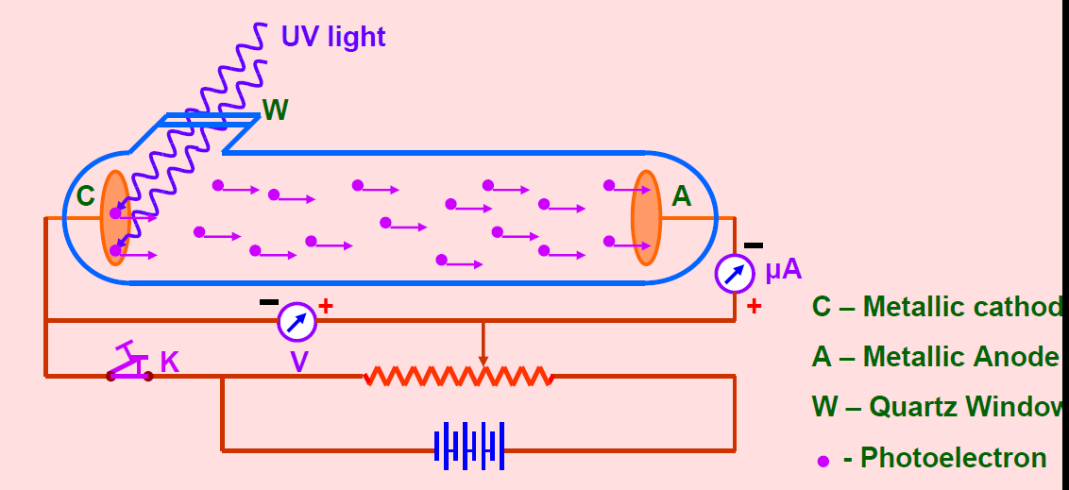
Experimental Set Up of the system

Slide 6
Glass is made of a material which only absorb UV but transfer visible and IR rays.
When a light ray of suitable energy ( frequency) falls on the cathode (Metallic) it emits photo electrons. These electrons moves towards anode due to attraction and hence constitute Photo Current.

Slide 7
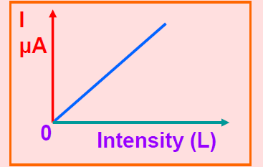
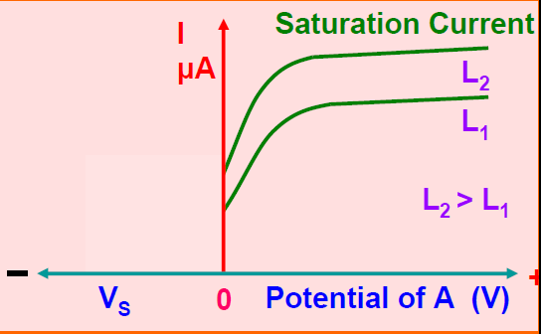
1. Effect of Intensity of incident light on Photoelectric current.
2. Effect of Potential on Photoelectric current.

Slide 8
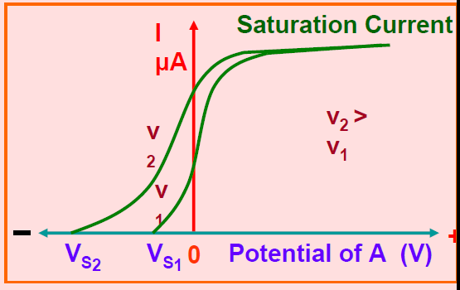
3. Effect of Frequency of incident light on Photoelectric current.
Higher the frequency higher the stopping potential.

Slide 9
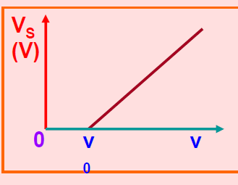
Threshold frequency:
The minimum frequency Below which there is no emissions of photoelectron takes place however high may be the intensity of the light.
It depends upon the nature of the material of the cathode.

Slide 10
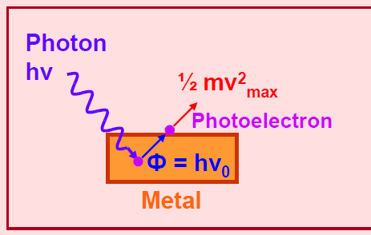
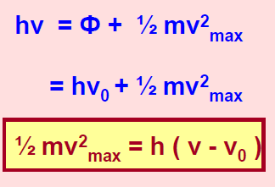
Einstein Famous Photos electric equation

