Slide 1
Periodic Table
Course Instructor: Dr. Atul Kumar Singh
Assistant Professor
Department of Chemistry
M. L. Arya College, Kasba
Purnia -854330
India

Slide 2
INTRODUCTION
According to Huxley, “The actual or ideal arrangement together of those which are alike and separation of those which are unlike; the purpose of this arrangement being primarily to disclose the correlations, or laws of union, or properties, or circumstances and secondarily to facilitate the operation of the mind in dearly receiving and then retaining in the memory the characteristics of the objects in question."

Slide 3
Brief Historical Development of the Periodic Table
1. Dobereiner's Law of Triads·
In between 1817 and 1829, Dobereiner gave law of triads. According to which in certain triads the atomic mass of the middle element was approximately equal to thee arithmetic mean of the atomic masses of the other two elements and the chemical properties of the middle element were in between triads of the end members.

Slide 4
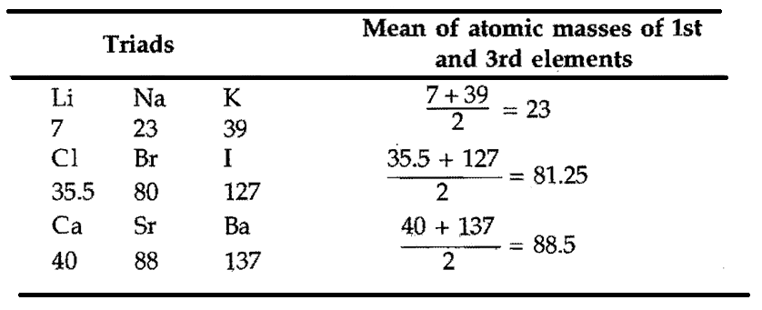
The main drawback of this classification was that the concept was applicable to only to a limited number of elements not all the known elements.

Slide 5
2. Newlands’ Law of Octave
In 1865, Newlands gave the law of octave. According to this law, if the elements are arranged in order of their increasing atomic weight, the. Physical and chemical properties of the elements repeat after interval of seven elements like 8th note of the musical. Scale.

Slide 6
The system worked quite well for the lighter elements but fails in the case of heavier elements

Slide 7
MENDELEEV'S PERIODIC LAW AND ORIGINAL PERIODIC TABLE
In 1869, a Russian scientist Mendeleev gave the periodic law. According to this law, “ When elements are arranged in the order of increasing atomic weight, elements with similar properties appear at regular intervals. The physical and chemical properties of elements are periodic functions of their atomic weight”

Slide 8
The main points of periodic law as stated by Mendeleev are below:
1. The elements, if arranged according to their atomic weights exhibit an evident periodicity of properties.
2. Elements which are similar as regards their chemical properties have atomic weights which either are of nearly same value, e.g., Fe, Co, Ni or increase regularly, e.g., K, Rb, Cs.
Mendeleev, D.I. 1889. The Periodic Law of the Chemical Elements. Journal of the Chemical Society 55: 634-656.

Slide 9
3. The arrangement of elements/or groups of elements in the order of their atomic weights corresponds to their so called "valencies" as well as their distinctive properties.
4. The elements which are most widely distributed in
nature have small atomic weights and possess sharply
defined properties.
5. The magnitude of atomic weight determines the
character of the element.
Mendeleev, D.I. 1889. The Periodic Law of the Chemical Elements. Journal of the Chemical Society 55: 634-656.

Slide 10
6. Many yet unknown elements may be discovered.
7. The atomic weight of an element may sometimes be
corrected with the aid of the knowledge of the atomic weights of the adjacent elements.
8. Certain characteristic properties of elements can be
foretold from their atomic weights.
Mendeleev, D.I. 1889. The Periodic Law of the Chemical Elements. Journal of the Chemical Society 55: 634-656.

Slide 11
Modern Periodic Law
In 1912, a British Physicist Henery Moseley discovered new property of element called atomic number and stated that the properties of elements are periodic functions of their atomic numbers.

Slide 12
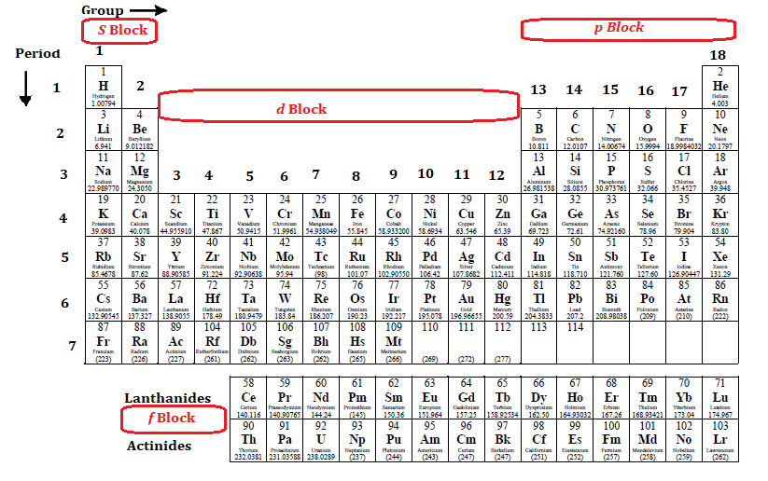
Modern Periodic Table

Slide 13
Modern periodic table
Nine vertical columns: groups
Seven horizontal rows: periods
Devided in to 4 Blocks
s –Block: receive the last electron in the s orbital
p –Block: receive the last electron in the p orbital
d –Block: receive the last electron in the d orbital
f -Block: receive the last electron in the f orbital

Slide 14
Thank you

