Slide 1
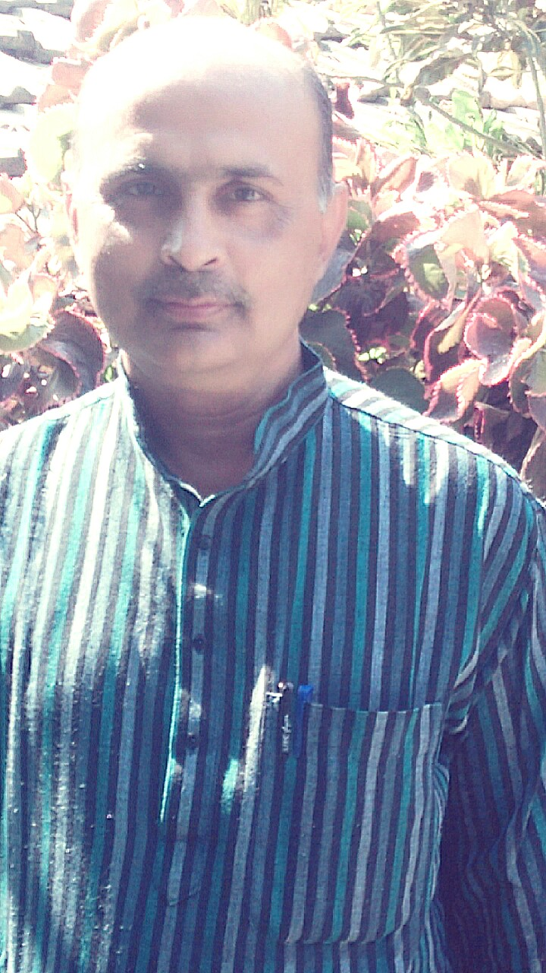
Dr. Manoj kumar singh, Dept. of Hindi ,
M.L.Arya College , Kasba , Purnia , Bihar
Notes:
Dr. Manoj kumar singh, dept. of Hindi , M.L.Arya College , Kasba , Purnia , Bihar

Slide 2
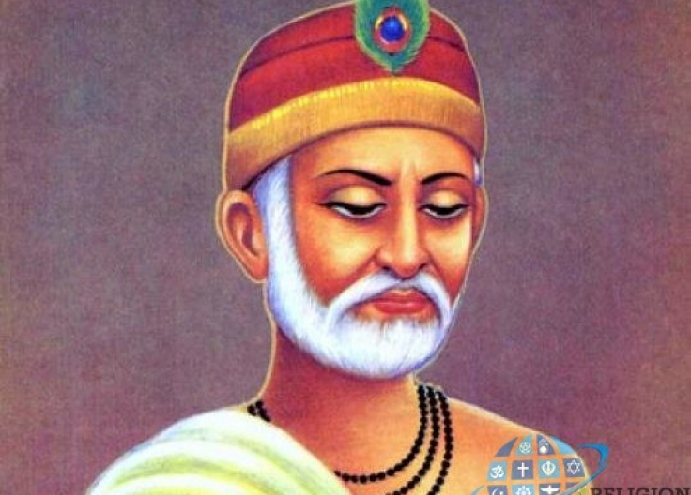

Slide 3
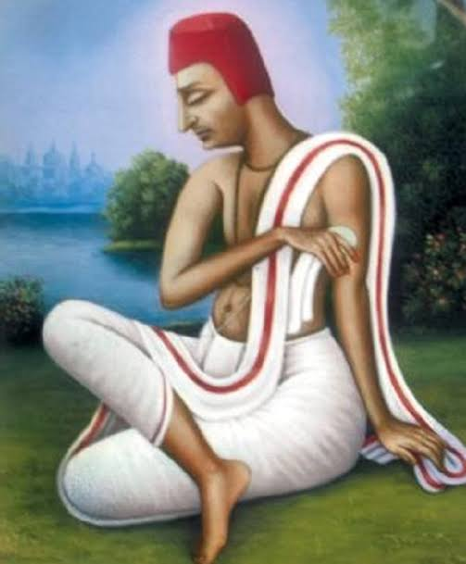

Slide 4
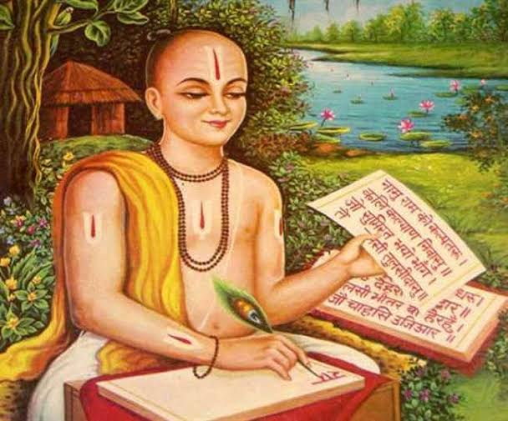

Slide 5
