Slide 1
B.COM 2
BY JAHANAVI DEO
DEPARTMENT OF COMMERCE
M.L ARYA COLLEGE, KASBA

Slide 2
Structure of indian banking

Slide 3
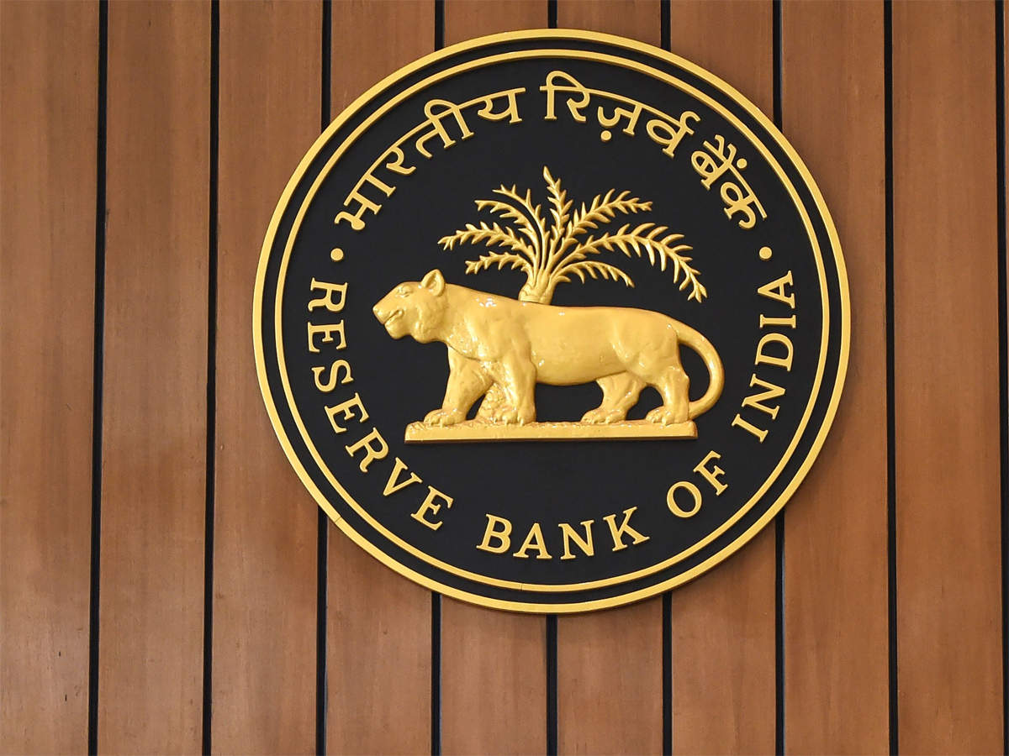
Reserve Bank of India (RBI):
The country had no central bank prior to the establishment of the RBI. The RBI is the supreme monetary and banking authority in the country and controls the banking system in India. It is called the Reserve Bank’ as it keeps the reserves of all commercial banks.

Slide 4
Commercial Banks
Commercial banks mobilise savings of general public and make them available to large and small industrial and trading units mainly for working capital requirements.
Commercial banks in India are largely Indian-public sector and private sector with a few foreign banks. The public sector banks account for more than 92 percent of the entire banking business in India—occupying a dominant position in the commercial banking. The State Bank of India and its 7 associate banks along with another 19 banks are the public sector banks.

Slide 5
Scheduled and Non-Scheduled Banks:
The scheduled banks are those which are enshrined in the second schedule of the RBI Act, 1934. These banks have a paid-up capital and reserves of an aggregate value of not less than Rs. 5 lakhs, hey have to satisfy the RBI that their affairs are carried out in the interest of their depositors.
All commercial banks (Indian and foreign), regional rural banks, and state cooperative banks are scheduled banks. Non- scheduled banks are those which are not included in the second schedule of the RBI Act, 1934. At present these are only three such banks in the country.

Slide 6
Regional Rural Banks:
The Regional Rural Banks (RRBs) the newest form of banks, came into existence in the middle of 1970s (sponsored by individual nationalised commercial banks) with the objective of developing rural economy by providing credit and deposit facilities for agriculture and other productive activities of al kinds in rural areas.
The emphasis is on providing such facilities to small and marginal farmers, agricultural labourers, rural artisans and other small entrepreneurs in rural areas.

Slide 7
Cooperative Banks:
Cooperative banks are so-called because they are organised under the provisions of the Cooperative Credit Societies Act of the states. The major beneficiary of the Cooperative Banking is the agricultural sector in particular and the rural sector in general.
The cooperative credit institutions operating in the country are mainly of two kinds: agricultural (dominant) and non-agricultural. There are two separate cooperative agencies for the provision of agricultural credit: one for short and medium-term credit, and the other for long-term credit. The former has three tier and federal structure.
At the apex is the State Co-operative Bank (SCB) (cooperation being a state subject in India), at the intermediate (district) level are the Central Cooperative Banks (CCBs) and at the village level are Primary Agricultural Credit Societies (PACs).
Long-term agriculture credit is provided by the Land Development Banks. The funds of the RBI meant for the agriculture sector actually pass through SCBs and CCBs. Originally based in rural sector, the cooperative credit movement has now spread to urban areas also and there are many urban cooperative banks coming under SCBs.

