Slide 1
AUDITING
JAHANAVI DEO
B.COM 1
DEPARTMENT OF COMMERCE
M.L ARYA COLLEGE,KASBA

Slide 2


Slide 3
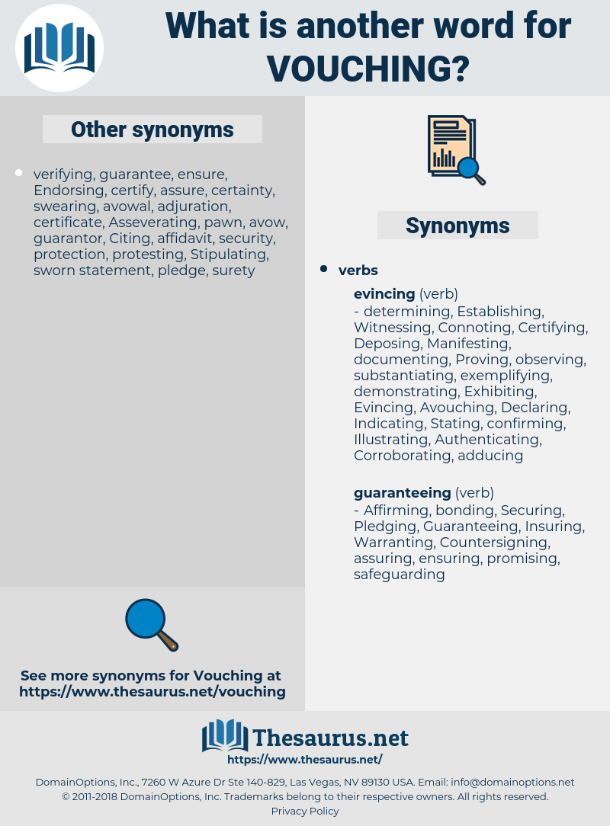

Slide 4
Importance:
Vouching is the act of checking evidential documents to find out errors and frauds and to know the authenticity, accuracy and reliability of books of accounts. Thus, it is important for an auditor due to the following reasons:

Slide 5
1. Vouching Is The Backbone Of Auditing
Main aim of auditing is to detect errors and frauds for proving the true and fairness of results presented by income statement and balance sheet. Vouching is only the way of detecting all sorts of errors and planned frauds. So, it is the backbone of auditing.

Slide 6
2. Vouching Is The Essence Of Auditing
Auditing not only checks the accuracy of books of accounts but also checks whether the transactions are related to business or not. All the transactions are performed after the prior approval of concerned authority or not, transactions are real or not because an accountant may include fictitious transactions to commit frauds. All these facts can be found with the help of vouching. So, vouching is essential for auditing.

Slide 7
3. Vouching Is Important To See Whether Evidences Are Correct Or Not
An auditor checks the books of accounts to detect errors and frauds. Frauds may be committed presenting duplicate vouchers. All the small and big amounts of frauds can be detected with the help of vouching. So, all the evidential documents and records are to be checked carefully and in detail by an auditor which is the scope of vouching.
Therefore, it can be said that vouching is the heart of auditing because without the work of vouching, the work of auditing cannot be performed.

