Slide 1
Specialised Accounting
By JAHANAVI DEO
Bcom 2
Department of Commerce
M.L Arya College, Kasba

Slide 2
Absorption of company
Absorption of Company is a way of business arrangement in which an existing company takes over the business of the another entity..

Slide 3
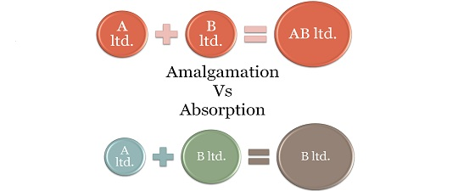

Slide 4
The entity who gets absorbed goes into the liquidation process. The payment for such absorption to the old entity can be made either in cash or in shares or mixture of both.
The absorbed company continue to run operations as it was doing before the absorption and staff continue to work under the new management. If any type of fund is being maintained for the employees of the company, it is taken over by the purchasing company.

Slide 5
There are so many reasons of absorption. One of them is that due to the formation of the new company, it will not get the reputation in the market as the old one. So, that is why, purchasing company absorbs an existing company to using its strength to exploit the opportunities exists in the market.

