Slide 1
BUSINESS ORGANISATION
BY JAHANAVI DEO
DEPARTMENT OF COMMERCE
M.L ARYA COLLEGE, KASBA

Slide 2
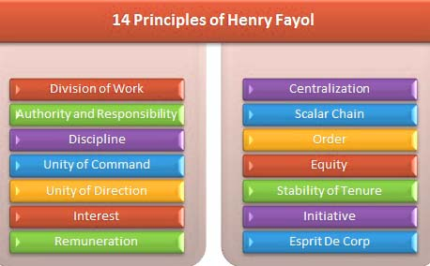
Principles of Management

Slide 3


Slide 4


Slide 5
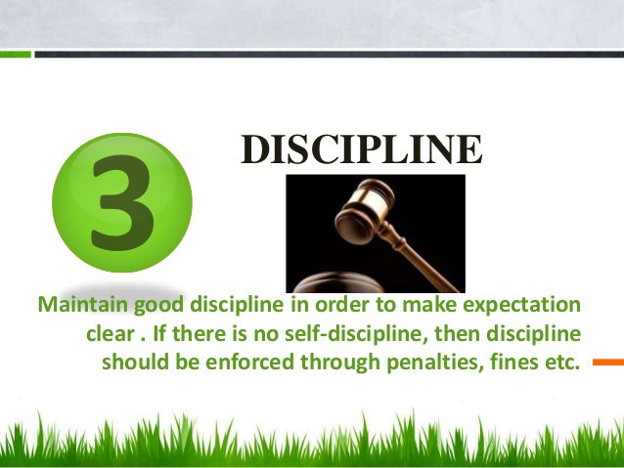

Slide 6


